Slide 1

Hear This, Wyoming!
Obtaining, Interpreting, Referring, and Following-up on Hearing Screening Results for Wyoming Infants, Toddlers, and Preschoolers
2013
Wyoming Early Hearing Detection and Intervention (EHDI) Program

Slide 2

Thank you so much for taking the time to be here.

Slide 3

Introductions, information, and our itinerary
The hearing screening system in Wyoming
Hearing, learning, and development
Hearing screening components
Rescreening and referrals
Role play and practice
“Hear” We Go!

Slide 4


Wyoming Early Hearing Detection and Intervention (EHDI) Program
Early Intervention & Education Services
Developmental Disabilities Section
Behavioral Health Division
Wyoming Department of Health

Slide 5

Who We Are
Nancy Pajak, MS, CCC-A
Wyoming EHDI Coordinator
Email: nanpajak@aol.com
Phone: 307.721.6212
Bradley H. Bakken, PhD
Wyoming EHDI Administrative Assistant
Email: nanpajak@aol.com
Phone: 307.721.6212
Susan Fischer, MS, CCC-SLP
Wyoming EHDI Clinic Coordinator
Email: susan.fischer@wyo.gov
Phone: 307.760.7931

Slide 6

Who Are You?
What’s your name?
Where do you live/work?
Where were you born?
Favorite part of fall?

Slide 7

Sign-in sheets
Handouts
Continuing education credit
  PTSB (sign-in sheet)
  STARS (sign-in sheet)
  Wyoming Board of Speech Pathology and Audiology (see us)
Your evaluations are very important to us!

Slide 8


Ask Questions!
Jump in! Don’t be shy!
Restroom
Notes:
This is animated

Slide 9

The road ahead…

Slide 10
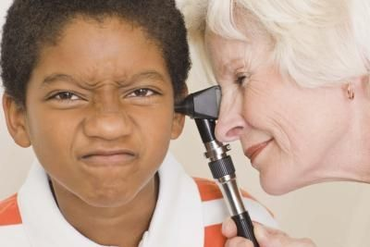
Purpose of This Training
- Understanding the who, when, why, and how of the hearing
screening process in Wyoming for kids from birth to start of kindergarten.
- The role of hearing in learning and development.
- Hearing screening components (i.e., otoscopic inspection, pure
tones, otoacoustic emissions [OAE], and immittance).
- Rescreening and referrals.
- Role play and practice.
- Any and all questions. Of course!

Slide 11


Purpose of This Training
A continuation of the ongoing effort to inform, update, and answer questions about Wyoming’s EHDI program.
To help you help kids…
Grow from the roots up.

Slide 12
Please complete the pre-test. When finished, pass it to Bradley.
☺ PURPLE ☺

Slide 13
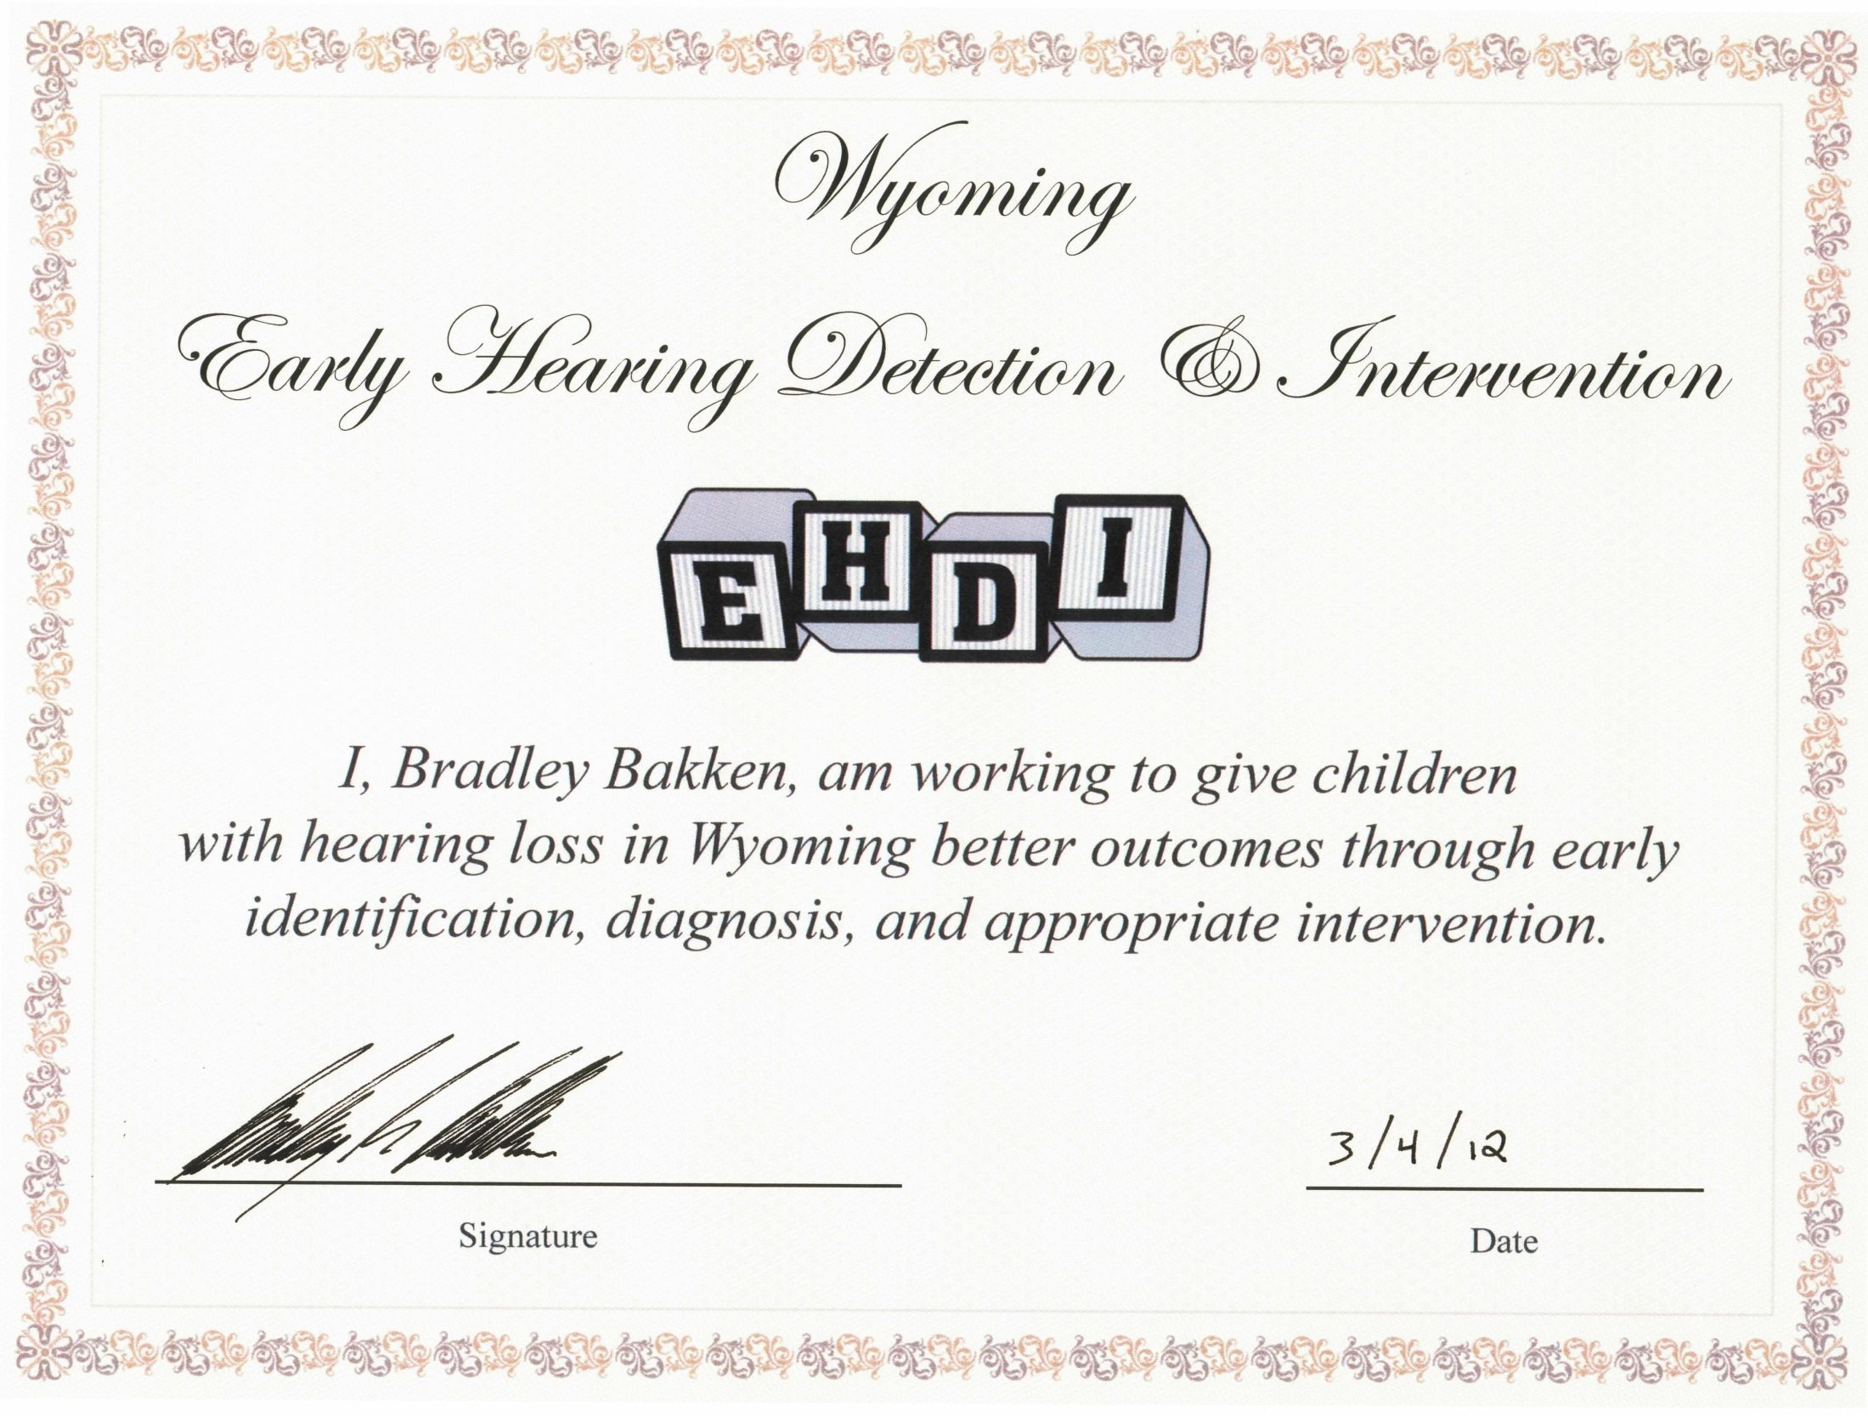

Slide 14

EHDI’s 1-3-6 goal:
EHDI has two parts
Part 1
Screened by 1 month of age.
Diagnosed by 3 months of age.
In appropriate intervention by 6 months of age.
Newborn hearing screening:
98% of Wyoming’s newborns are screened in the hospital
prior to discharge.
We catch up with border and transfer babies as soon as we can.

Slide 15
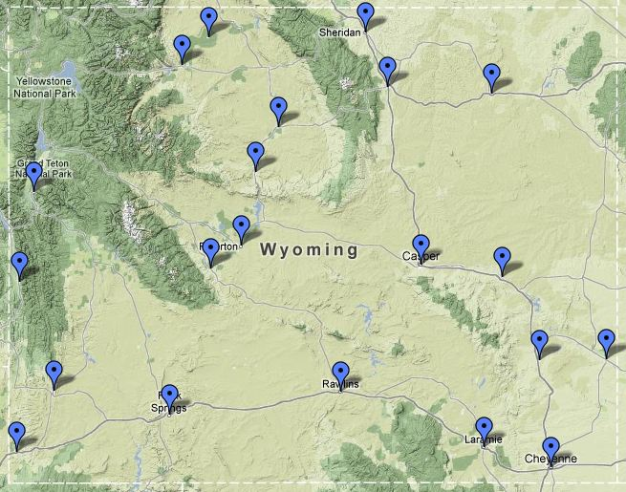
Wyoming’s 21 birthing hospitals

Slide 16
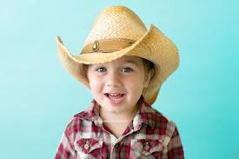
Late onset hearing loss (LOHL):
EHDI has two parts
Part 2
After the child leaves the hospital and before s/he enters kindergarten.
Periodic/annual LOHL hearing screenings.

Slide 17
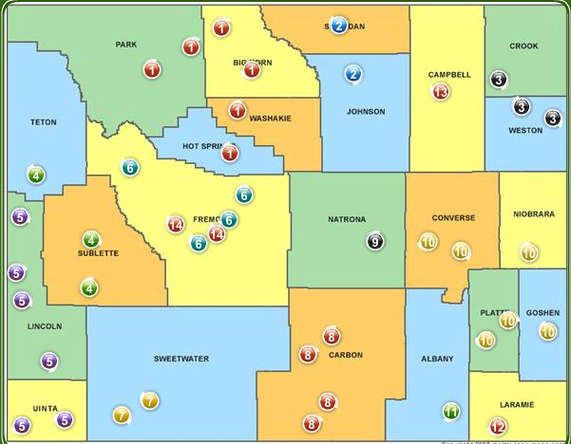
Wyoming’s 42 child development centers
LOHL/periodic childhood screening sites

Slide 18

Wyoming’s HHH System
All newborn hearing screening data are entered.
All hearing screening data from Wyoming’s 42 child development centers are entered.
Educational and medical personnel will be able to access the information via the Total Health Record (THR)… When?
Built upon standardized hearing screening procedures for the birth to 5 years-old population.

Slide 19
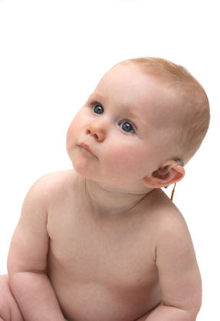
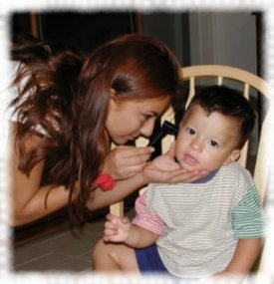
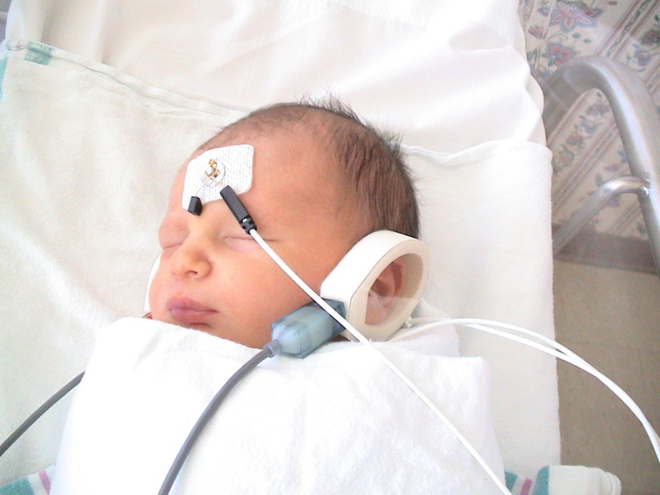
The EHDI System in Wyoming
Brief history of EHDI
1992 National Institutes of Health (NIH) study
1999 legislation in Wyoming
Select data for newborns in Wyoming

Slide 20

Why all this fuss about hearing?
Literacy! Literacy!! Literacy!!!

Slide 21

Hearing, Learning, and Reading
Auditory cortex development plays a pivotal role in the acquisition of spoken communication, reading, and academic skills in children with typical hearing as well as in children with all degrees of hearing loss.

Slide 22

Children need 200 exposures to a new word in context for that word to become a part of their vocabulary.
90% of a young child’s knowledge is from the incidental reception of conversations around them – overhearing conversation.
    It’s all auditory!!!

Slide 23
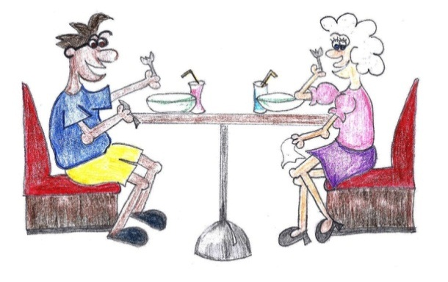
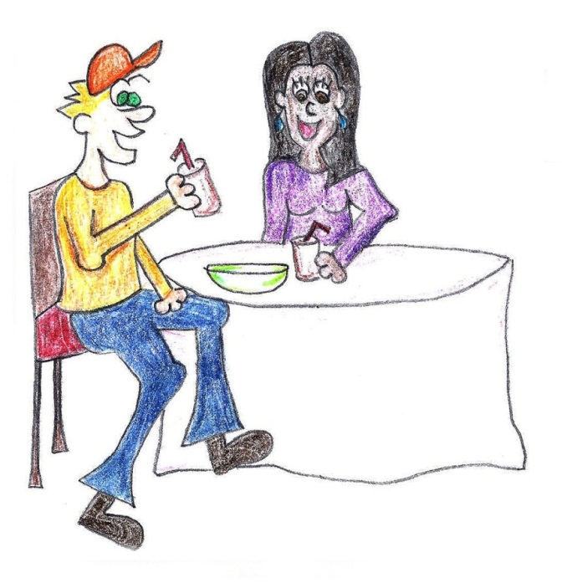
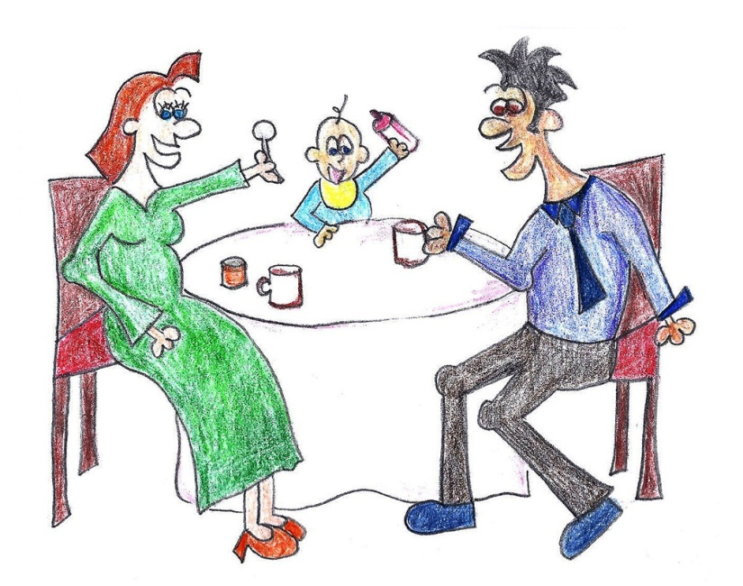
OMG!
OMG! What are you feeding him?!

Slide 24
OMG!
Your new cut and color looks really nice.
OMG!
OMG!
Thanks, babe.
OMG! What are you feeding him?!

Slide 25
OMG!
Your father and I think it’s time for you to move out.
OMG!
Your new color and cut looks really nice.
OMG!
OMG!
Thanks, babe.
Thanks, babe!
OMG! What are you feeding him?!
What are you feeding him?!

Slide 26

“Now it’s time for your hearing lesson”.

Slide 27
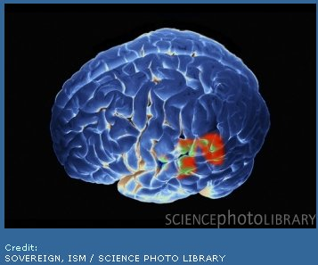

Brain
Hearing
Brain
Reading

Slide 28

The connection between hearing and reading…
We are neurologically programmed to process spoken language and reading through the auditory centers of the brain.
  - Confirmed by brain mapping
  - Reading is auditory not simply visual

Slide 29
Connecting the Dots
Hearing
Learning
Literacy
Notes:
Animated

Slide 30

Hearing begins the process of:
Communication
Hearing
Writing
Listening
Reading
Talking

Slide 31
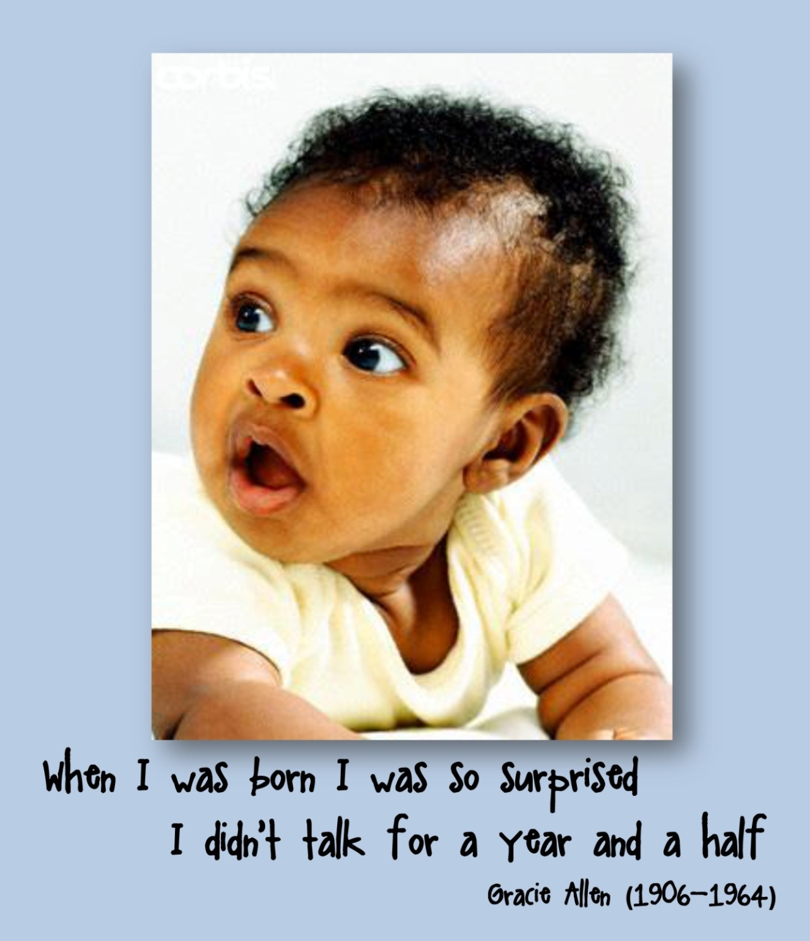
In the beginning…
The ear is formed and functional by the 5th month of gestation.
During the first year of life, a baby hears words over and over – a redundant signal.
It takes a great deal of hearing and listening before verbal language forms.

Slide 32
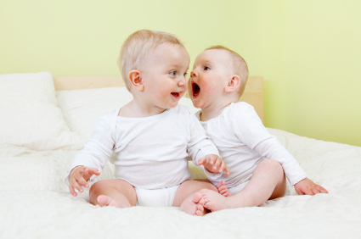
Baby’s First Words
First word occurs at approximately 12 months of age. That’s 16 months after hearing began (4 gestational, 12 after birth).
Speech develops naturally because we hear.

Slide 33


What happened that first year?
Good example of data input preceding data processing.
  Data is entered in the auditory cortex portion of the brain via audition (just as you would enter data into a computer via the keyboard).

Slide 34
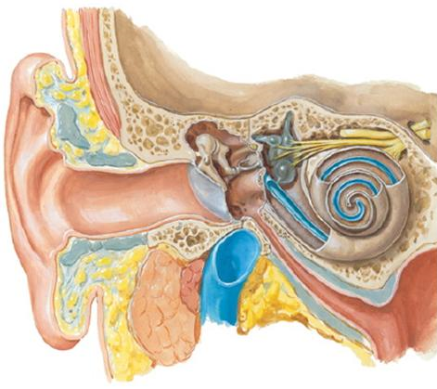
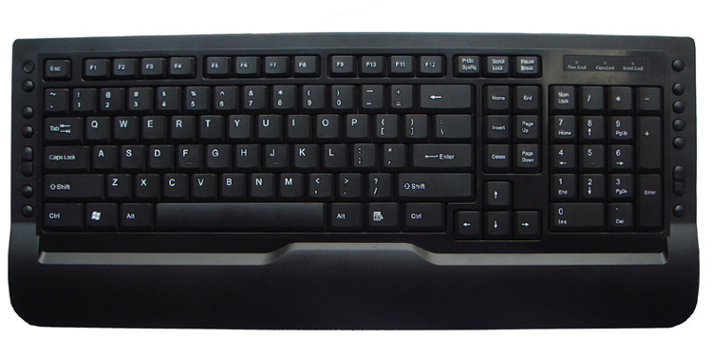
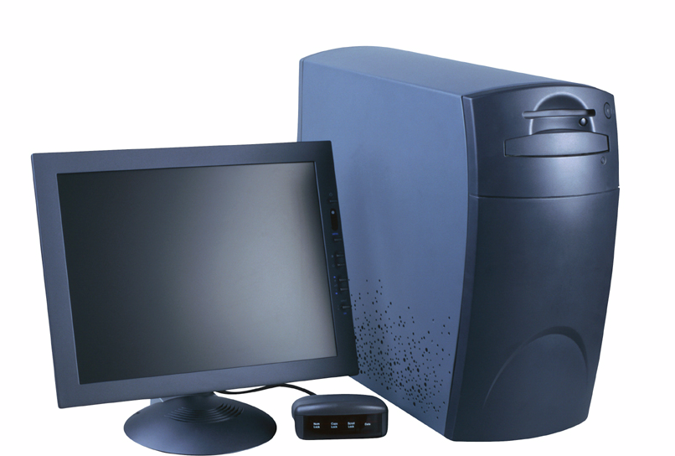
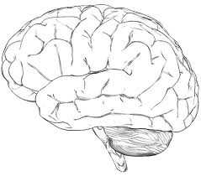
Think...
…the ears are the keyboard;
the brain is the hard drive/CPU.

Slide 35
Hearing, learning, and reading
If “data” are entered inaccurately, incompletely, or inconsistently, (analogous to using a malfunctioning keyboard), the child will have incomplete and/or inaccurate auditory information to process.
How can we expect a child to learn well when the auditory information that reaches his/her auditory cortex is not complete (as is the case for a child with hearing loss)?
We hear with the brain. The ears are just the way in!

Slide 36
Hearing, learning, and reading
Once the keyboard is repaired, allowing data to be entered accurately (analogous to the child’s hearing loss being managed), what happens to all the previously entered inaccurate and incomplete information?
Unfortunately, the correct data needs to be re-entered. That is, reheard and retaught.
There is no “find function” to convert inaccurate data to complete and accurate information.
Therefore, the longer a child’s hearing remains unrecognized and unmanaged, the more far reaching the effects…

Slide 37
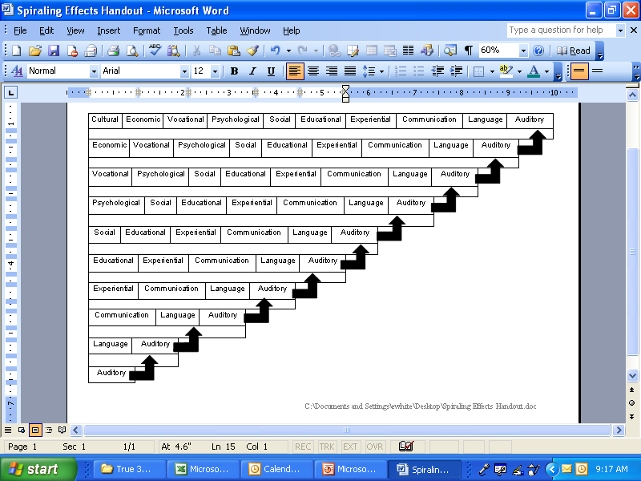
Spiraling Effects of Hearing Loss

Slide 38

Hearing, learning, and reading
The exciting news is: timely, appropriate management and intervention that capitalizes on brain neuroplasticity allows for spoken language and literacy outcomes never before imagined for those with all degrees of hearing loss.
Time is of the utmost importance!

Slide 39
Quiz/Clicker Time!
A child with hearing loss may have developmental delays in which areas of his/her life?
Speech/Language
Cognitive
Social
All of the Above

Slide 40
American Developmental and Educational Systems

Slide 41
The child that begins kindergarten with 5,000 words should finish high school knowing 90,000–100,000 words.
500,000 Words in the English Language
They get them through audition and reading.
Notes:
Animated

Slide 42
The Child with Hearing Loss…
Most likely does not have the 5,000 words his/her kindergarten classmates have (incomplete data)
And may not have the same level of general knowledge.

Slide 43
Language and Literacy
We are neurologically programmed to process spoken language and reading through the auditory centers of the brain
  Confirmed by brain mapping
  Reading is auditory rather than visual

Slide 44
Educational and Developmental Systems are Auditory
Listening is the classroom cornerstone:
  45% of a student’s day is spent in listening activities.
Hearing is the Velcro™ to which other skills such as attention, spoken language, reading, and academic competencies are attached.

Slide 45
Do you Know the Answer?
Studies show that 80-90% of students who struggle with learning to read have weak......
Phonological Awareness

Slide 46
Hearing and Reading
Children must have access to sound (hear) in order to develop phonological awareness, grammar, syntax, semantics, and pragmatics.
Good hearing screening programs will start the identification process of those who do not have adequate access to sound (hearing).
Screening is the critical, beginning step
to facilitate literacy development!

Slide 47
Typical Preschool Classroom Scenario
In the beginning, we provide a redundant signal to kids in many modes (e.g., get out your yellow crayon…)
  We talk about it
  We show it
  And we even help them find the yellow crayon
Around 3rd grade we change things…it gets more complicated…

Slide 48
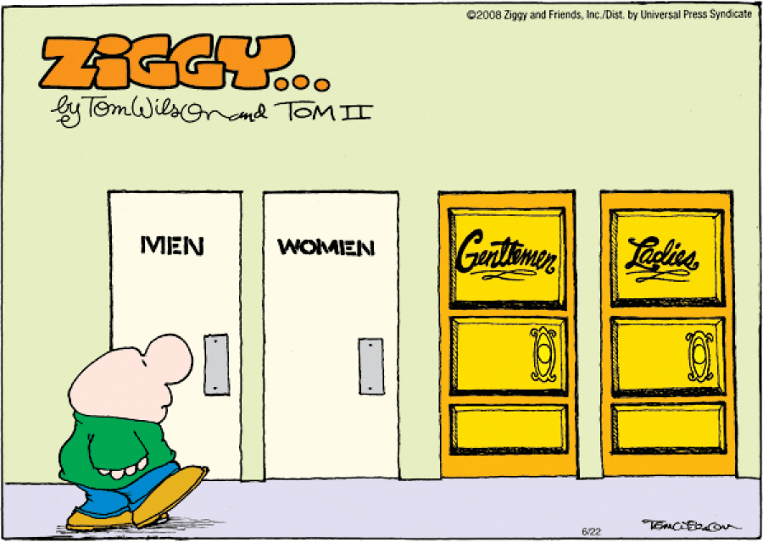
English Language

Slide 49
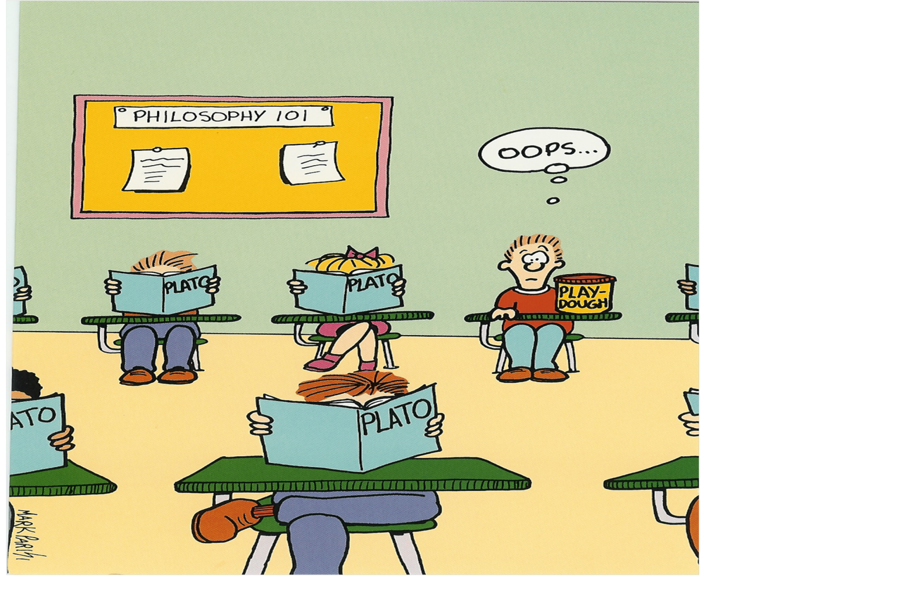
If we do not identify and properly manage ear/hearing problems….

Slide 50
So... hearing leads to language communication and reading
And that gives one a lifetime of opportunities and possibilities.

Slide 51
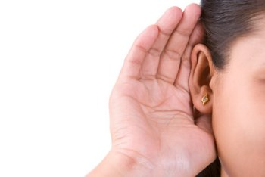
Hearing Loss………
What does it “sound” like?

Slide 52
FACTS/Misconceptions About Hearing Loss:
People with hearing loss simply hear things softer. MISCONCEPTION!
Hearing loss filters speech; some sounds are heard more clearly than others. FACT!
People are deaf or hearing. MISCONCEPTION!
  Less than 5% of individuals with hearing loss are deaf.
Hearing loss is a continuum of gray, not all or nothing – not on/off, not black/white. FACT!

Slide 53
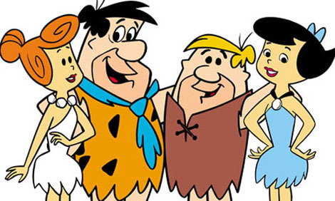
Hearing Loss Simulation
Flintstones

Slide 54

Visual Analogy of Understanding Speech When Hearing is Within “Normal” Limits

Slide 55

Visual Analogy of Understanding Speech With a “Minimal” (25 dB HL) Hearing Loss

Slide 56

Visual Analogy of Understanding Speech With a “Mild” (40dB HL) Hearing Loss

Slide 57

Visual Analogy of Understanding Speech With a “Moderate” (60 dB HL) Hearing Loss

Slide 58
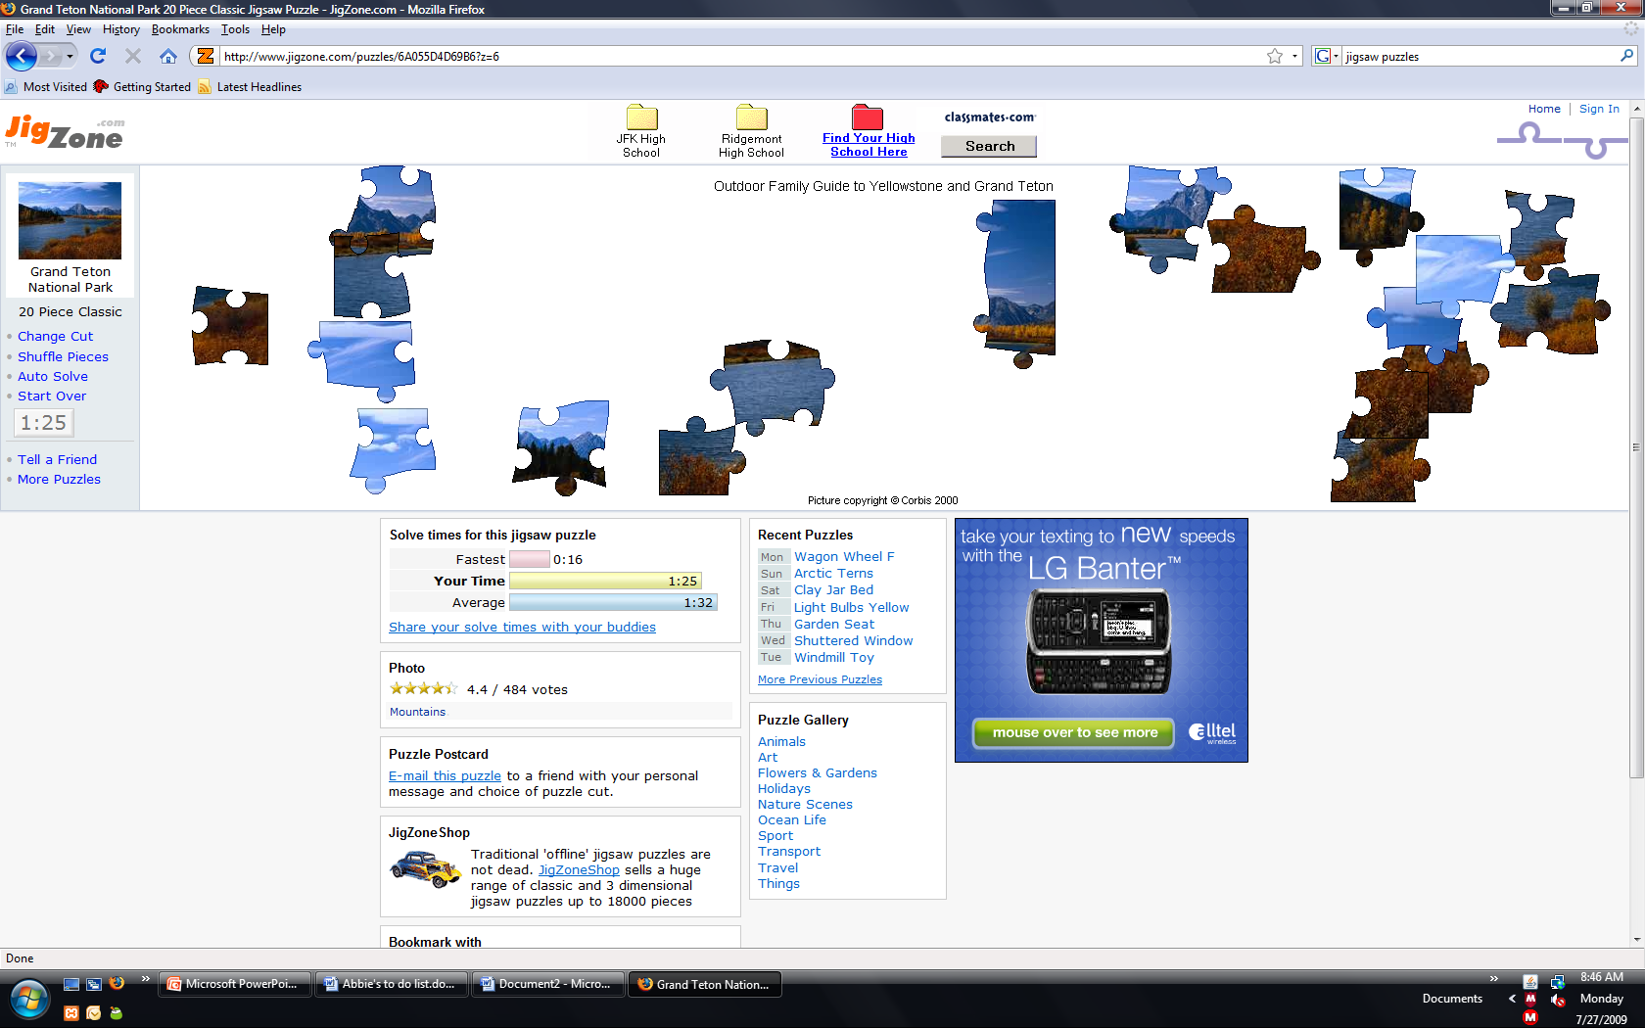
Visual Analogy of Understanding Speech With a “Severe” (80 dB HL) Hearing Loss

Slide 59
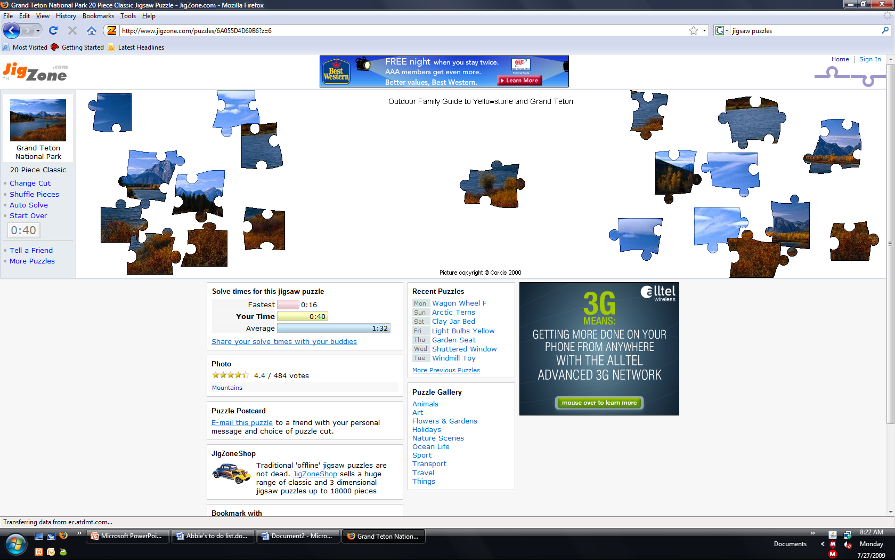
Visual Analogy of Understanding Speech With a “Profound” (95 dB HL) Hearing Loss (deaf)

Slide 60
Visual Analogy of Understanding Speech With a “Severe” (80 dB HL) Hearing Loss

Slide 61
Visual Analogy of Understanding Speech With a “Moderate” (60 dB HL) Hearing Loss

Slide 62
Visual Analogy of Understanding Speech With a “Mild” (40dB HL) Hearing Loss

Slide 63
Visual Analogy of Understanding Speech With a “Minimal” (25 dB HL) Hearing Loss

Slide 64
Visual Analogy of Understanding Speech When Hearing is Within “Normal” Limits

Slide 65
Good examples of hearing loss simulations can be found here:
www.betterhearing.org
“Hearing Loss”
“Hearing Loss Simulator”
Notes:
Could this be set up as a link too?

Slide 66
CLICKER TIME!
Which is true about hearing loss?
People are deaf or hearing.
Hearing loss filters speech so that some sounds are heard more clearly than others.
People with hearing loss simply hear things softer.

Slide 67
Hearing
versus
Understanding

Slide 68
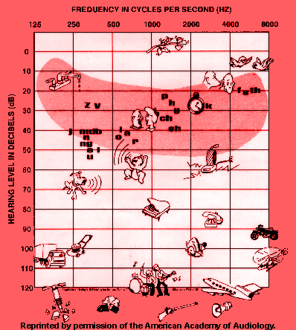
FAMILIAR SOUNDS AUDIOGRAM
Frequency; Pitch; Hertz (Hz)
  Low frequency-vowels
  High frequency-consonants
  ‘Power’ vs. understanding
  300-4000 Hz most critical for understanding speech

Slide 69
FREQUENCY IN CYCLES PER SECOND (HZ)
125
250
500
1000
2000
4000
8000
LOW PITCH
HIGH PITCH

Slide 70
JUST INTERESTING….
Human: 20-20,000 Hz
Dog: 60-45,000 Hz
Bat: 2000-110,000 Hz
Porpoise: 75-150,000 Hz
Mouse: 1000-91,000 Hz
Tuna: 50-1100 Hz

Slide 71
Familiar Sounds Audiogram
Loudness; decibel (dB)
  Normal conversation is about 50 dB HL

Slide 72
SOFT
0
10
20
30
40
50
60
HEARING LEVEL (dB HL)
70
80
90
100
LOUD
110
120

Slide 73
Vowels vs. Consonants
_ _ O _ _

Slide 74
Vowels vs. Consonants
C L _ C K

Slide 75
AN EXAMPLE OF THE ABILITY TO
HEAR SPEECH WITH A HEARNG LOSS
NORMAL HEARING: Freddie thought he should find a whistle.
MILD HEARING LOSS Freddie though- -e --ould -ind a whi—e.
MODERATE HEARING LOSS: -reddie --ough- -e --ould -i-- a --i—le.
SEVERE HEARING LOSS --e—ie --ou--- -e --ou-- -i-- a --i—le.
PROFOUND HEARING LOSS LOUDsoft LOUD soft soft LOUD soft…….
Notes:
This is animated
I know we have this slide but this is nice cuz it is animated.

Slide 76
Milder degrees of hearing loss may not be
problematic for a linguistically mature person (i.e., an adult with good attending skills and someone who is wanting to communicate),
BUT
a ‘minimal’ hearing loss can sabotage
the overall development of a child who is
in the process of learning language.

Slide 77
Spelling Test
“Number your paper from 1 to 10.”
1.
2.
3.
4.
5.
6.
7.
8.
9.
10.
1.
2.
3.
4.
5.
6.
7.
8.
9.
10.
1.
2.
3.
4.
5.
6.
7.
8.
9.
10.

Slide 78
125
250
500
1000
2000
4000
8000
1.
Shoe
0
2.
Tree
10
20
z
v
f th
3.
Math
p
s
30
h
g
4.
Desk
ch
40
j
mdb
l
sh
n
o
a
ng
r
5.
Snack
50
e i
HEARING LEVEL (dB HL)
u
60
6.
Miss
70
7.
Test
80
8.
Thumb
90
9.
100
Fish
110
10.
Spill
120
AUDIOGRAM OF FAMILIAR SOUNDS
Click on Speaker to
Present Spelling word.
FREQUENCY IN CYCLES PER SECOND (HZ)
Notes:
Abbie, be sure to hide this slide in the handout—don’t want them to have the answers!

Slide 79
Results
Could you HEAR the words?
Could you UNDERSTAND the words?
How many did you get correct?
How can we develop language and reading skills if we get HALF the auditory information?

Slide 80
“When can hearing loss be educationally/
developmentally significant?”
Always!!!
Notes:
Animated

Slide 81
“How Many Children Have Educationally/Developmentally Significant Hearing Loss?”
Children who wear hearing aids or who use cochlear implants have educationally/developmentally significant hearing loss.
Very true. But, there are so many more children with hearing loss.

Slide 82
80% of children (4-10 years) have a temporary hearing loss sometime during the school year.
Hearing loss is not ‘low incidence’.

Slide 83
Where do all these kids come from?
At birth, 3/1000 babies have permanent, bilateral hearing loss.
This number triples (9/1000) by kindergarten entry.

Slide 84
Middle Ear Disease
Children with middle ear disease have fluctuating hearing loss.
Across all ages, otitis media with effusion (OME) increased 150% between 1975 and 1990.
Below age 2, OME increased 224% during the same period.
    More kids in day care.
    Increased allergens in the air.
    Ways to detect its presence.

Slide 85
Noise Induced Hearing Loss (NIHL)
The amount of environmental noise has doubled each decade for the last 20 years.
5.2 million children in the U.S. between 6-19 years of age have some degree of NIHL.
47 million iPods on the market with an output of 115-120 dB.
  7 minutes at this level causes damage.
  Sound quality is good; less distortion – they sound good loud.

Slide 86
Noise Induced Hearing Loss (NIHL)
iPod rules for normal hearing children:
  Less than 60% volume; and
  Less than 2 hours per day.
In Wyoming:
  Outdoor activities (e.g., hunting, snowmobiles, 4-wheelers, chainsaws); and
  Agriculture (tractors and other farm machinery).

Slide 87
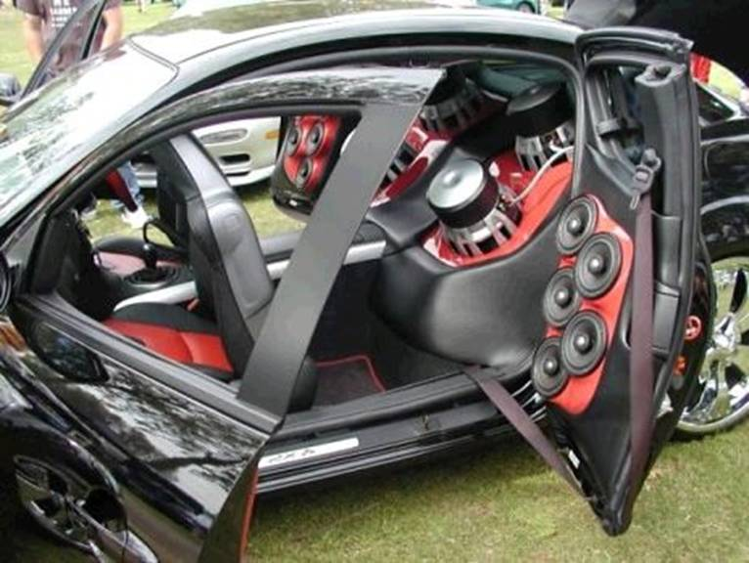
Too Loud??

Slide 88
Noise Induced Hearing Loss (NIHL)
http://www.usatoday.com/news/health/2010-08-18-hearing18_st_N.htm?csp=34news
1 in 5 U.S. teens with hearing loss.
(8-17-2010)

Slide 89
NIHL
A recent study found that teenagers exposed to smoke performed worse across every sound frequency tested and were more likely to have one-sided or unilateral low-frequency hearing loss.
While all children born in the U.S. are screened for hearing loss, this study underscores the importance of regularly screening children who are exposed to secondhand smoke.

Slide 90
CLICKER TIME!
What can cause Noise Induced Hearing Loss (NIHL)?
The use of iPods
Firearms
Chainsaws
A, B, and C

Slide 91
In Summary…
Phonological awareness is essential for reading success.
Auditory access is essential to phonological awareness.
Audition is the cornerstone of our developmental educational system.
Auditory access is key to student success.
Good hearing screening programs are one of our best avenues to ensure auditory access.
Notes:
Just a recap of previous points and an intro to this section

Slide 92

Purpose of Hearing Screening
Hearing Loss is Invisible!
FAIL the children with hearing loss,
and pass the children with normal hearing.

Slide 93
Hearing Screening Mandates
Part of EHDI (state legislation) and part of school accreditation requirements (Wyoming).
Also part of Child Find in Individuals with Disabilities Education Act (IDEA; federal) that is included in CDC contracts.
In contracts with child development centers.

Slide 94
The Letter of the Law
Screening
Vs.
The Intent of the Law
Identification, management, follow-up, and intervention occurring in a timely manner

Slide 95
Hearing Screening Programs
Preventive aspect
  Finding a problem as early as possible and providing intervention
Systematic and methodical
Pass/Fail
Must have follow-up procedures in place
Cookie cutter approach

Slide 96
When we screen, refer, and follow-up appropriately, there are better outcomes for all children!

Slide 97
Screening
Vs.
Testing/Evaluating
We screen and refer,
but we do NOT test or diagnose.

Slide 98


Slide 99
Components of
Hearing Screening for LOHL in Wyoming

Slide 100
Hearing Screening Procedures
1) Otoscopic inspection;
2) Pure tones or otoacoustic emissions (OAE); and
3) Immittance.

Slide 101

Screening Manual
Available at
www.wyomingehdi.org
Materials -> Download Materials

Slide 102
What are we looking (screening) for?
Disorders or problems in the outer, middle, or inner ear can prevent sound from reaching the brain.
Good hearing screening programs allow us to identify these problems and initiate intervention.

Slide 103
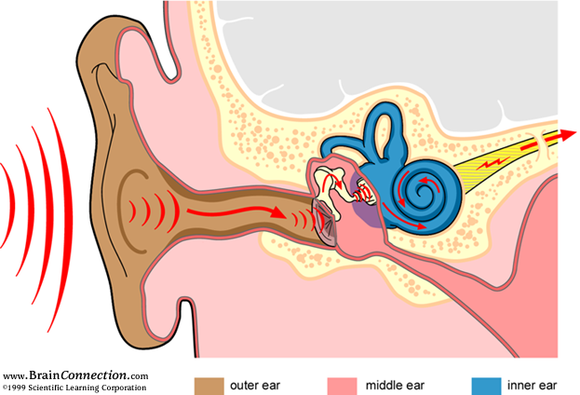

Slide 104
Anatomy
The auditory system consists of four parts:
Outer or External Ear
Middle Ear
Inner Ear
Central Auditory System

Slide 105
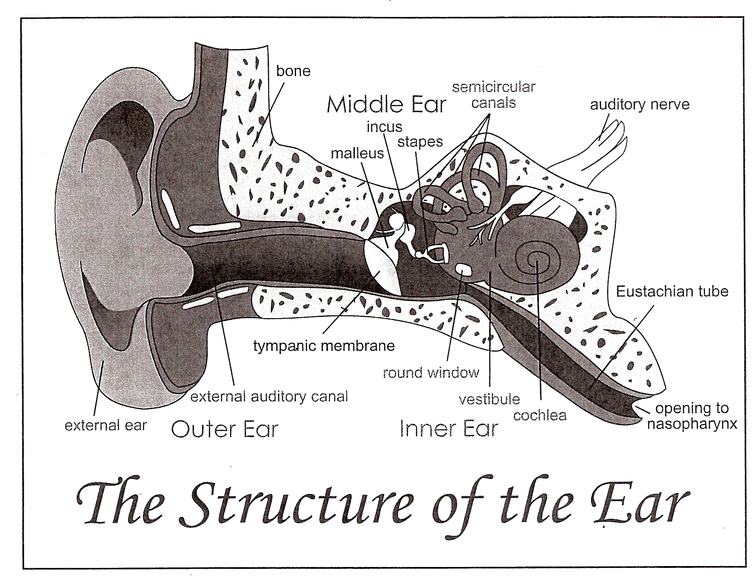

Slide 106
Outer Ear
Also called the external ear
Includes the outer ear canal and the pinna
Main purpose is to funnel sound
Sound is air-borne energy
Disorders
  Wax (cerumen) impaction - most common
  External otitis or “swimmer’s ear”
  Foreign objects

Slide 108
Middle Ear
The area between the external ear and inner ear. Includes:
  Tympanic membrane
  Ossicles (small bones that transmit information from the eardrum to the cochlea)
  Opening to the Eustachian tube
About the size of the end of your little finger or the size of an aspirin

Slide 109
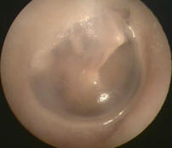
Normal Eardrum (Tympanic Membrane)
http://www.entusa.com/eardrum_and_middle_ear.htm

Slide 110
Middle Ear
Air-filled space
Air-borne energy becomes mechanical energy in the middle ear
Some disorders
  Otitis media; fluid; effusion (OME)
  Negative middle ear pressure
  The Eustachian tube is most likely the culprit

Slide 112
Inner Ear
Consists of the cochlea (snail-shaped) which has thousands of tiny hair cells
Cochlea is fluid filled
Invisible with otoscopy
Sound reaching the inner ear becomes hydraulic energy

Slide 113
CLICKER TIME!
What separates your outer ear
from your inner ear?
Panama Canal
Cochlea
Middle ear
Eustachian tube

Slide 114
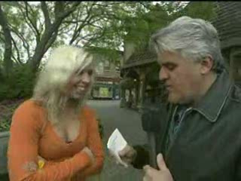

Slide 115
Types of Peripheral Hearing Loss
Conductive
Sensorineural
Mixed

Slide 116
Conductive Hearing Loss
Occurs when the sound is not ‘conducted’ through the external ear or the middle ear
Typically improves with treatment
Most common hearing loss in children
  Developmental concerns
  Health issue
Mild to moderate degree of hearing loss
Fluctuations in hearing status

Slide 117
Conductive Hearing Loss
Abnormalities causing conductive hearing loss may be visible
Causes of conductive hearing loss
  Malformed ear canal
  Fluid in the middle ear
  Problem with the ossicles
  Eustachian tube dysfunction
  Wax (cerumen) impaction
  Perforated tympanic membrane

Slide 118
Sensorineural Hearing Loss
Occurs in the inner ear (either in the cochlea or nerve of hearing)
Typically permanent and non-fluctuating
‘Invisible’ to otoscopic examination making hearing screening critical to its identification
Degree of hearing loss may be mild to profound

Slide 119
Sensorineural Hearing Loss
Congenital causes may include
  Heredity (recessive); genetics
  Maternal infections
Acquired causes may include
  Childhood infections; e.g., meningitis
  Skull fracture
  Drugs (-mycin; chemo)
  Noise

Slide 120
Mixed Hearing Loss
Sensorineural and conductive hearing loss existing simultaneously
May include the outer, middle, and inner ear
Fluctuations in hearing status

Slide 121
Screening tools look at different sections of the ear.
Otoscopic Inspection (not examination)
  Looks at the outer ear
Pure tones/otoacoustic emissions (OAEs)
  Looks at the inner, middle, and inner ear
Immittance
  Looks at the outer and middle ear

Slide 122
Summary
Otoscopic Inspection
Outer Ear
Conductive Hearing Loss
Pure Tones/ OAEs
Outer, Middle, and Inner Ear
Sensorineural Hearing Loss
Immittance
Outer and Middle Ear
Conductive Hearing Loss

Slide 123
Immittance
Evaluates the function of the middle ear (ME) system and the ME space which is an air-filled cavity about the size of an aspirin
Screens for health issues, NOT hearing acuity
Objective measurement
Appropriate for Wyoming children 9 months of age and older
Not done if there is a foreign object in the ear canal

Slide 124
Immittance – How It ‘Works’
Probe assembly has 3 openings
  Microphone
  Tone
  Air
The tympanic membrane (TM) is moved by the air and the microphone measures the reflection of sound (tone) from the TM
Similar to pneumatic otoscopy
  Pneumo = air

Slide 125
Immittance Terminology
Tympanometry (eardrum; measurement)
Tympanometer (eardrum; instrumentation)
Tympanogram (eardrum; graph)

Slide 126
Immittance Technology
  Ear Canal Volume (ECV); Physical Volume (PV)
  Tympanic Membrane Compliance (TMC)
  Middle Ear Pressure (MEP)
  Tympanometric Width (TW); Gradient
      (not currently using)
Acoustic Reflex (AR) or Stapedial Reflex

Slide 127
Tympanometry
Tympanometry is not dependent upon hearing
  In the presence of permanent sensorineural hearing loss, if the mechanical system is intact and functioning normally, tympanograms that are within normal limits can be expected
Remember: children with sensorineural hearing loss can have middle ear problems

Slide 128
Tympanometry…
Tells us whether a child needs to be referred for medical evaluation and/or treatment.
Provides a very quick, very accurate, physiologic measurement that helps us understand the condition of the middle ear.
Can provide information to assist the physician in the appropriate management of children with middle ear problems.

Slide 129
Tympanometer
The instrument used to obtain immittance measurements.
Also known as an immittance bridge.
Screening tympanometers are automatic and provide a reading for each component of the tympanogram.
Should be serviced/calibrated at least annually.
Consult the user’s manual about care of the instrument.

Slide 130
Tympanogram…
A graphic representation of tympanometric measurements. The components of the tympanogram are:
  1) Ear Canal Volume (ECV)—the amount of space between the probe tip and wherever the air can’t get any farther.
    Useful in estimating P.E. tube status; identifying possible perforations or wax occlusions.
    Important for you to compare the ears.
    Typical ECV by age:
          7-24 months: <0.8 mL
          2-6 years: <1.0 mL
          Older children: 0.4-1.5 mL

Slide 131
Tympanogram
  2) Tympanic Membrane (TM) Compliance - How much did the TM move in response to the changing air pressure introduced in the ear canal?
    If there is something behind the TM (such as fluid or in front of the TM such as impacted wax) the movement or compliance of the TM will be reduced
    Also known as static compliance (SC)
  3) Middle Ear Pressure (MEP) - Air pressure at which the TM moves the most.
    Also known as the point of maximum compliance or the peak of the tympanogram.

Slide 132
Acoustic Reflex (AR) or Stapedial Reflex
In a normal middle ear, if a loud sound is introduced, the middle ear muscles will contract causing stiffness.
Most immittance equipment provides a graphic representation of that contraction; this is a present AR.
Value: helps you interpret questionable (low compliance) tympanograms.

Slide 133
An acoustic reflex may not be present in a normal ear, but…
it is not present in an abnormal ear.

Slide 134
CLICKER TIME!
What part(s) of the ear does the tympanometer/immittance bridge screen?
The outer ear only
The outer and middle ear
The middle ear only
The middle and inner ear
The inner ear only

Slide 135
Performing Immittance Measurements
Otoscopic inspection will reveal the size and direction of the ear canal.
Probe tip selected should be larger than the canal opening.
  The intent is to obtain an airtight seal at the canal opening; the tip is not inserted into the ear canal itself.
Fit the base of the rubber tip over the end of the metal or plastic probe stem assembly on the tympanometer so that it goes completely over the probe stem.

Slide 136
!!!!!!!!!!!!!
Getting and maintaining a good seal at the canal opening is the most important variable to obtaining accurate and reliable immittance measurements.
!!!!!!!!!!!!!!!!!!!!!

Slide 137
Performing Immittance Measurements
Gently pull the top of the test ear up and back to straighten the canal.
Apply the probe tip firmly to the canal opening.
If you have difficulty maintaining a seal, remove the probe, reexamine the direction of the canal and try again.
  Changing the size of the probe tip may be helpful.

Slide 138
Performing Immittance Measurements
Most tympanometers have a light indicating that the test is in progress as well as a light indicating the completion of the measurement.
When you are finished you’ll have a tympanogram and if the option was selected, an indication of whether or not an acoustic reflex was present.
If the ear fails, immediately repeat the measurement being sure that you have a good probe fit.

Slide 139
Directions to the Child
Few, if any, directions are needed - the child simply needs to sit or stand quietly.
  Infants and toddlers on a familiar lap.
  Having preschoolers stand is a good option.
Don’t ask permission. Instead, something like “This looks in your ear like I did” or “This checks your eardrum” is adequate.

Slide 140
Directions to the Child
Useful diversions for young children:
  Have a mirror for them to look into.
  They can watch the lights on the equipment.
  Having them watch the trace develop may keep them occupied while the measurement is completed.
  Talking to them as the measurement is being done will also help them be still.

Slide 141
We’ve completed an overview of
immittance measures and how they are performed. Now, lets take a
closer look at the components of the tympanogram.

Slide 142
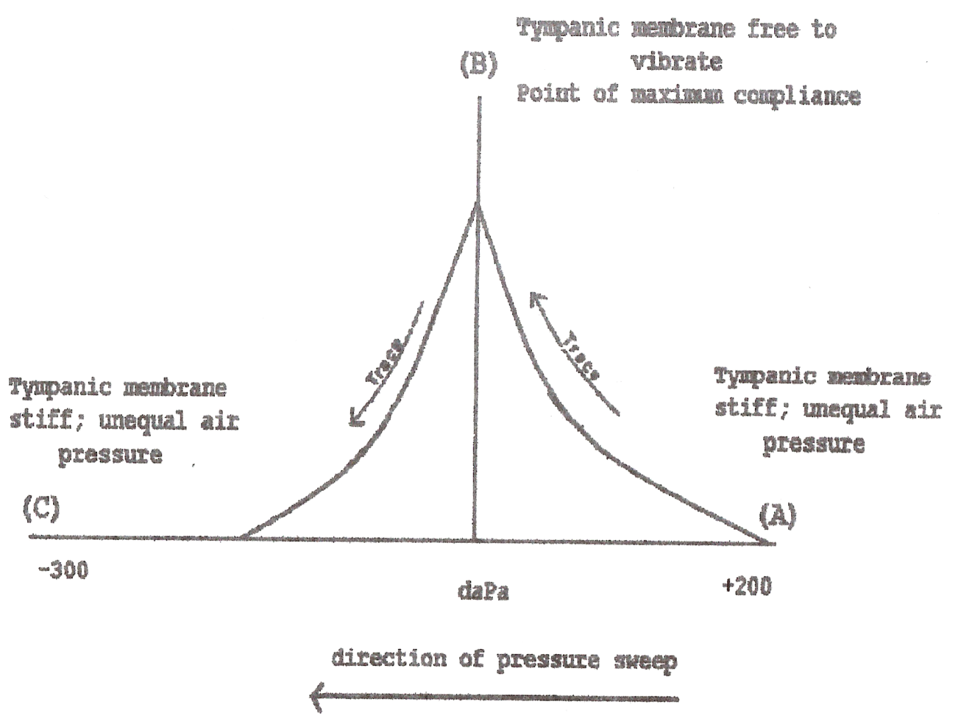
Normal Tympanogram
A = VOLUME measurement
Positive air pressure is introduced which increases stiffness and decreases compliance

Slide 143

Normal Tympanogram
B = MEP measurement
Eustachian tube function
When the air pressure on both sides of the TM is =, a peak on the tympanogram will occur
  Point of maximum compliance
  Compliance peak

Slide 144
Normal Tympanogram
COMPLIANCE is the difference between A and B
  The difference between the stiffest point and the most compliant point
  How much did the TM move?
  Sometimes called static compliance

Slide 145
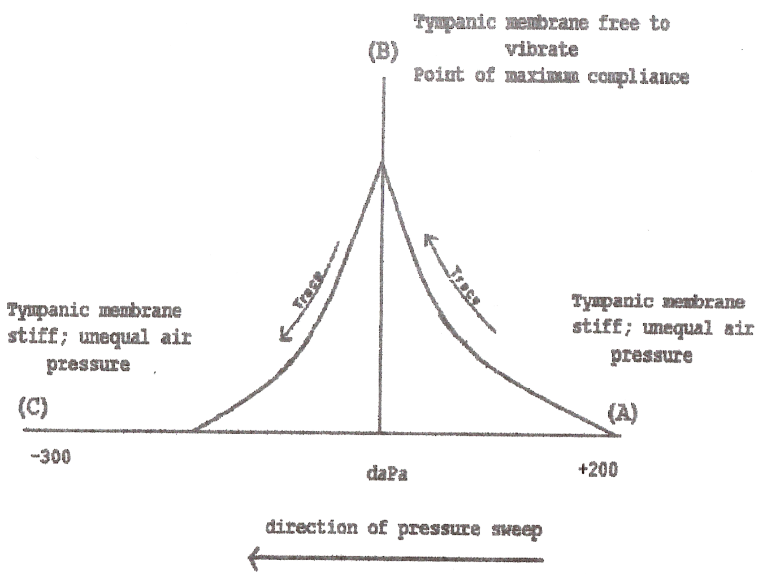
Normal Tympanogram
As the pressure is lowered, the TM is again stiffened; point C

Slide 146
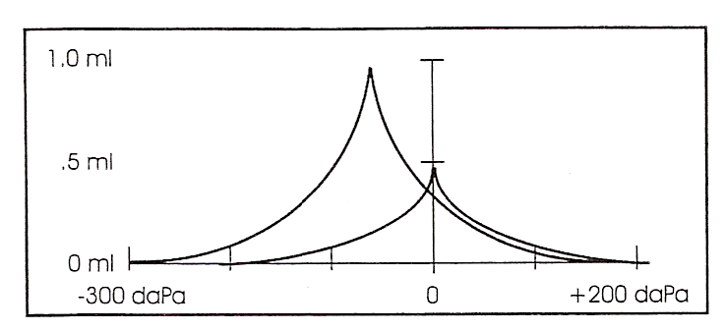
Normal Tympanogram

Slide 147
“You Can’t Have One Without the Other”
We’re now going to take a look at each of the components of the tympanogram - their significance and how they’re related to each other.
Middle ear pressure, ear canal volume, and tympanic membrane compliance are very much related, and understanding that relationship will help you judge the validity of the numbers and to determine if it is a pass or fail.

Slide 148
Ear Canal Volume
Provides information about the integrity of the tympanic volume; is it intact?
Large volumes are indicative of a hole or perforation in the tympanic membrane.
  Injury
  Effusion bursts the TM
  Tube has fallen out leaving a hole
You may not see a hole otoscopically but the air will find a hole you can’t see

Slide 149
A large volume measurement in the presence of tubes suggests that the tube(s) is open or patent or that the tube has fallen out leaving a perforation.
Small volumes are indicative of something in front of the tympanic membrane which is blocking or occluding the canal.
  Most common cause for small ECV is wax. You may not be able to see the tympanic membrane due to wax, but that doesn’t mean its occluded; the air can find a passage you can’t see.
  OR… you may be holding the probe tip against the wall of the ear canal.

Slide 150
Normal Tympanogram
A = VOLUME measurement
At point A, positive air pressure is introduced to the external ear canal which stiffens and decreases compliance of the TM. (No manipulation of the TM has occurred to obtain MEP and comp. values)

Slide 151
Tympanic Membrane (TM) Compliance
TM compliance values represent the ability of the TM to move; a normal, healthy TM moves back and forth—it is compliant or mobile
Anything behind the TM (other than air) reduces the compliance or movement of the TM
  Fluid or effusion is the most common cause
Anything in front of the TM that is blocking the ear canal will produce a low compliance value
  Impacted wax is the most common cause
Reduced compliance may result in a flat tympanogram

Slide 152
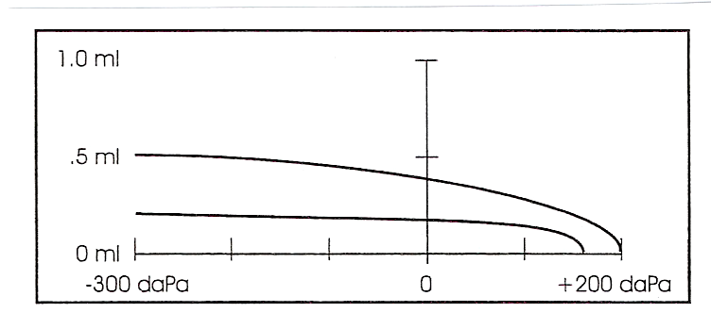
Flat Tympanogram, Low Compliance

Slide 153
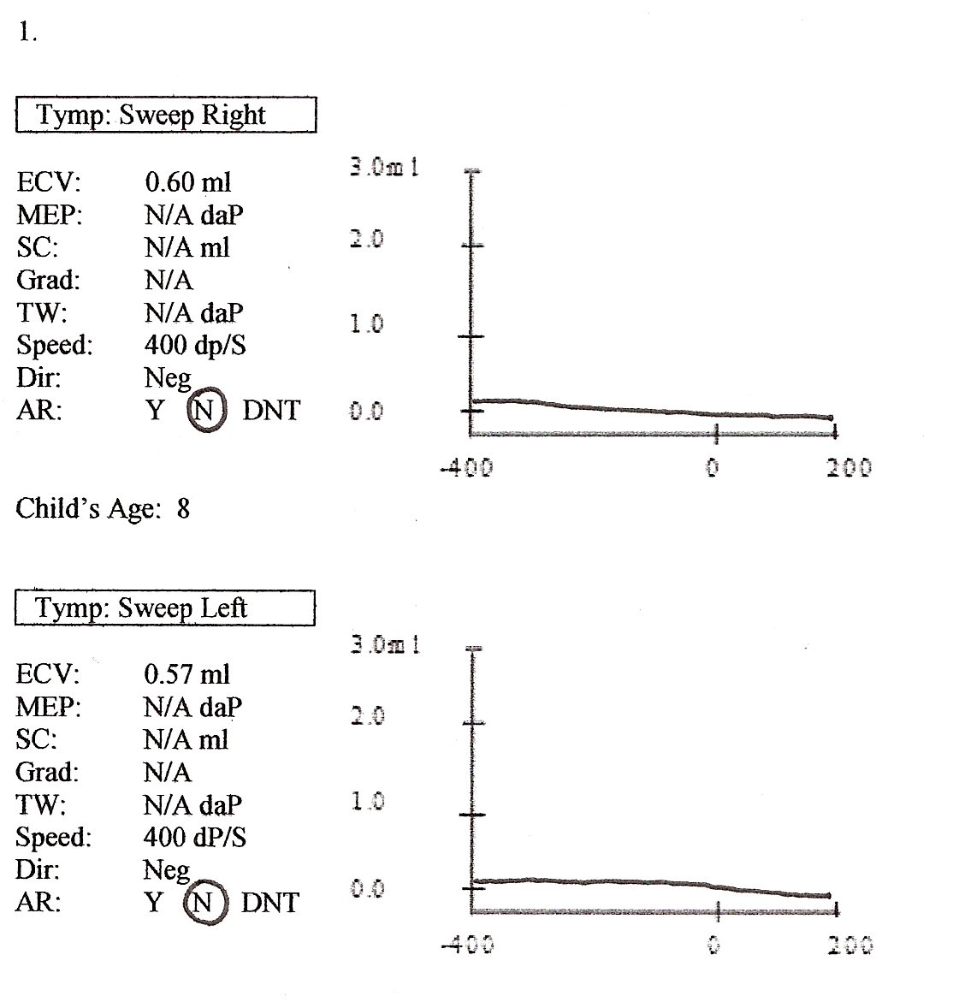

Slide 154
Middle Ear Pressure (MEP)
The MEP value is the point at which the air pressure on both sides of the tympanic membrane is equal.
Synonymous terms (dependent upon your tympanometer).
  Compliance peak or Peak.
  Point of maximum compliance.
Normal MEP is O daPa.
Screening tympanometers usually a sweep from +200 to -300 or -400 daPa to determine the MEP value.

Slide 155
Middle Ear Pressure (MEP)
Abnormal MEP is typically in the negative direction.
Negative MEP indicates a poorly functioning Eustachian tube.
Seldom see MEP >+50 though it may occur in the beginning stages of otitis media.
The significance of negative MEP is that it occurs before and after effusion.
As negative MEP increases, the TM becomes retracted and less compliant.

Slide 156
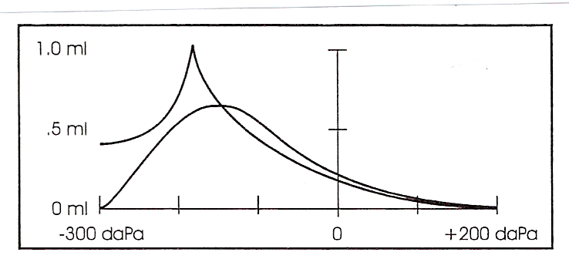
Negative Pressure

Slide 157
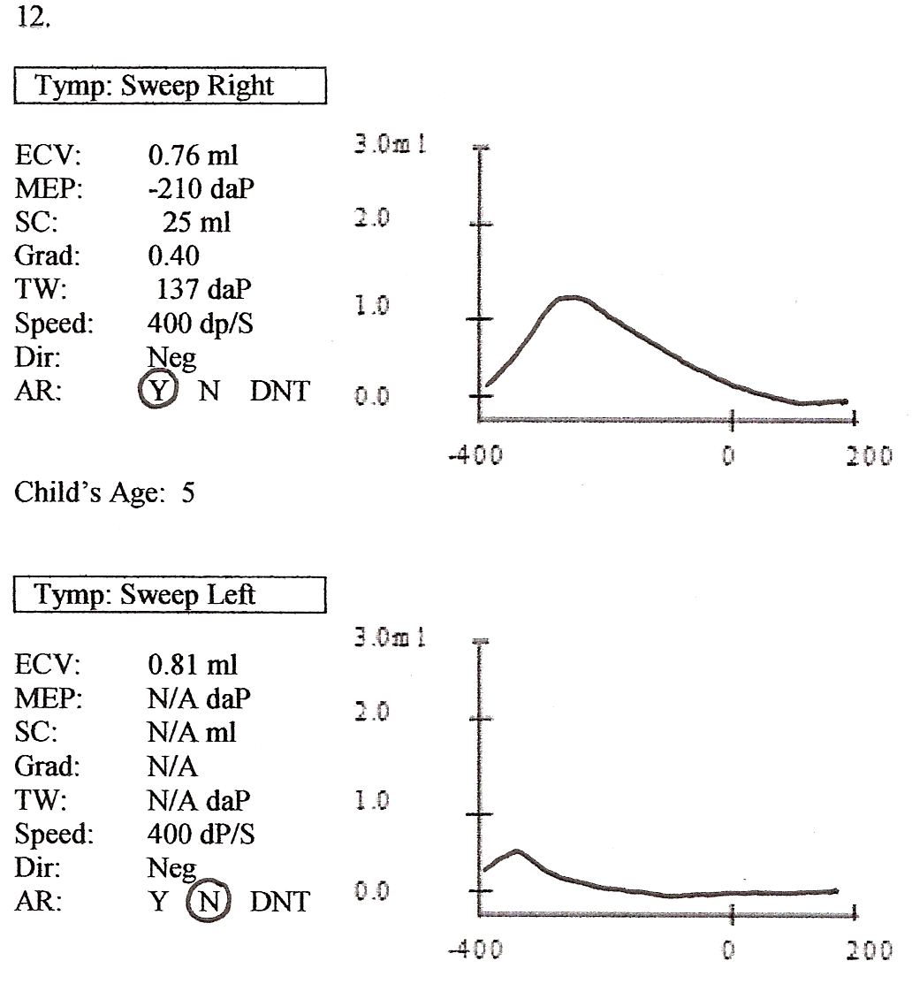

Slide 158
CLICKER TIME!
Which of the following Middle Ear Pressures would cause the ear to fail the screening?
+98 DaPa
+40 DaPa
0 DaPa
-75 DaPa
-251 DaPa

Slide 159
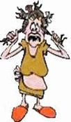
Doin’ OK?...Hang in There…
Notes:
Animated

Slide 160
For practice, lets go through some
different scenarios and consider the immittance results, what they may be indicating, and why!

Slide 161
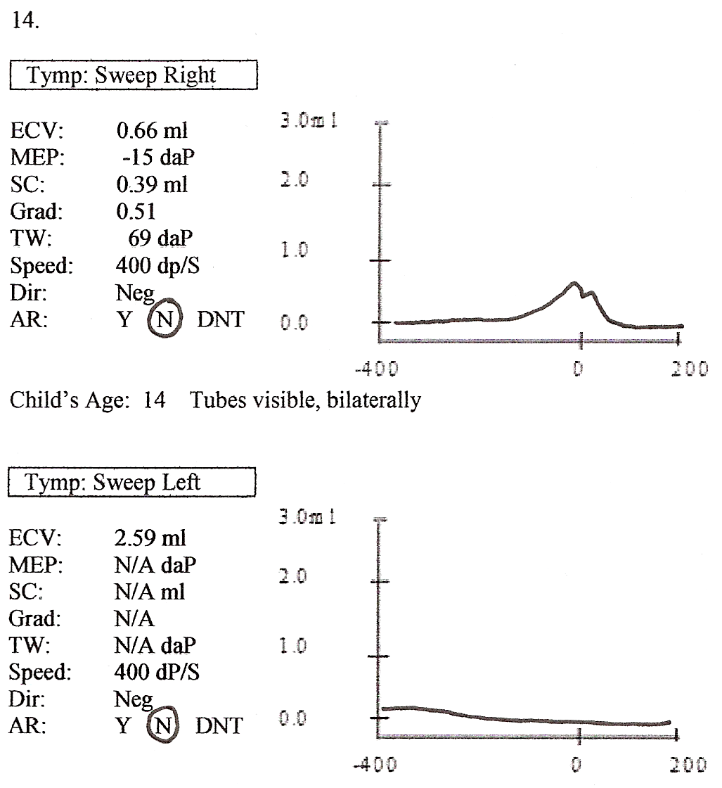
Scenario 1
Results
  Visible P.E. tube
  Large ECV
  Low compliance (or no value)
  No value for MEP
  AR absent

Slide 162
Scenario 1 (continued)
Suggest
  Open (patent) tube OR the tube has fallen out leaving a perforation.
Why
  ECV large because the air went through the TM and included the ME space in the measurement.
  Compliance and MEP unavailable because both are dependent upon movement of the TM.
    TM must be intact to get those measurements.
Action
  Provide this information to the managing physician.
  Student back into the screening schedule.

Slide 163
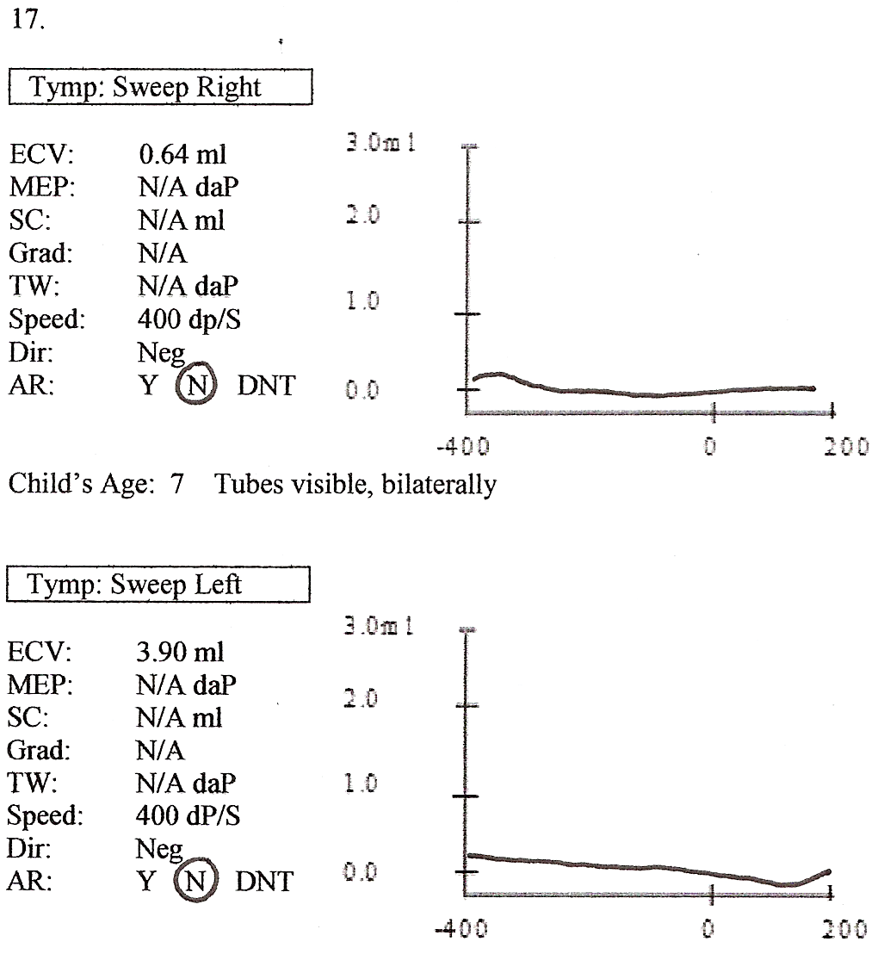
Scenario 2
Results
  Visible P.E. tubes
  Normal ECV
  Low compliance (or no value)
  No value for MEP
  AR is absent

Slide 164
Scenario 2 (continued)
Suggest
  Plugged tube
  Effusion may be present
Why
  Plugged tube caused the ECV to be normal
  Weight of the tube in the TM prevents movement of TM
  MEP can’t be obtained without movement of the TM
Action
  Medical referral
  Rescreen 4-6 weeks

Slide 165
Scenario 3
Results
  Visible P.E. tubes
  Normal ECV
  Normal compliance and MEP
  AR is absent

Slide 166
Scenario 3 (continued)
Suggest
  Tube has fallen out of TM
  TM has healed
  ME function is within normal limits
Why
  Normal ECV suggests TM is intact
  Normal compliance and MEP possible only when TM is intact and ME function is normal
  It is OK that the AR is absent
Action
  Provide this information to the managing physician
  Student back into screening schedule

Slide 167
REMEMBER:
Viewing with an otoscope is one-dimensional.
It is therefore difficult to know if the tube is open (patent) or if it has fallen out of the tympanic membrane.
Your immittance results provide valuable information.

Slide 168
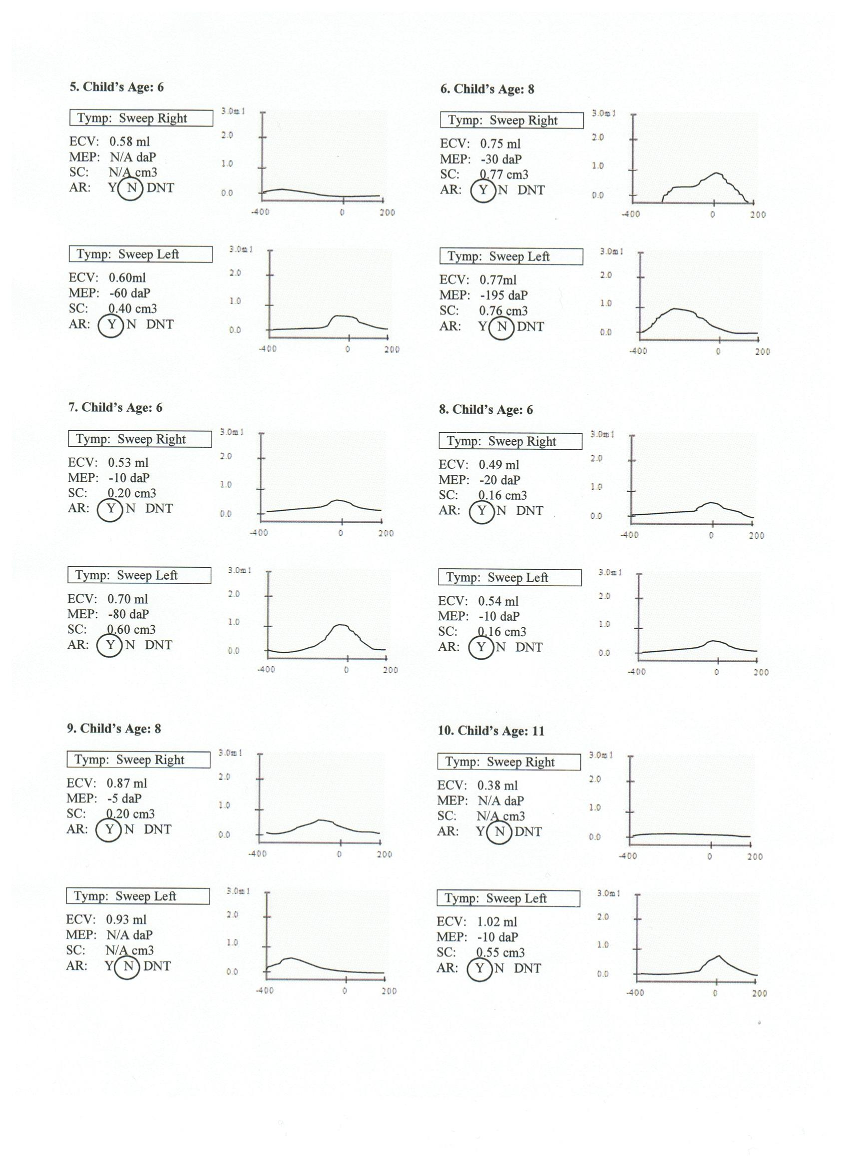
Scenario 4
Results
  ECV seems large
  Compliance and MEP are normal

Slide 169
Scenario 4 (continued)
Suggest
  ME function is normal
Why
  ECV is not suggesting a perforation because compliance and MEP are normal: normal compliance and MEP are not possible with a perforation

Slide 170
Scenario 5
Results
  Small ECV
  Low compliance (or no value)
  No value for MEP
  AR is absent

Slide 171
Scenario 5 (continued)
Suggest
  Small ECV suggests canal is occluded.
  Possible wax impaction.
Why
  Small ECV indicates something (wax) is “taking up space” and blocking the ear canal making it impossible for the air to move the TM.
    Low compliance (or no value) reflects the TM’s lack of movement.
  MEP unavailable because the TM couldn’t be moved in order to identify a point of maximum compliance.
Action
  Medical referral.
  Rescreen 4-6 weeks.

Slide 172
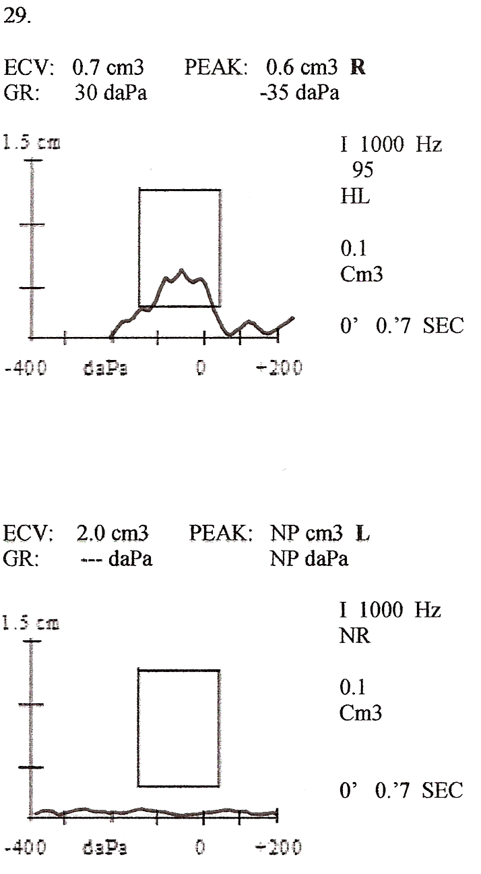
Scenario 6
Results
  Otoscopic inspection, unremarkable
  Large ECV
  Low compliance (or no value)
  No value for MEP
  Absent AR

Slide 174
Scenario 6 (continued)
Suggest
  Perforation.
Why
  Large ECV due to air filling the ear canal and the ME space.
  Compliance and MEP values unavailable because an intact TM is necessary in order to obtain those values.
Action
  Medical referral.
  Rescreen 4-6 weeks.
  Remember: air will find a hole you can’t see.

Slide 175
Scenario 7
Results
  Normal ECV
  Low compliance (or no value)
  No value for MEP
  Absent AR

Slide 176
Scenario 7 (continued)
Suggest
  ME effusion
Why
  Presence of effusion (fluid) rather than air behind the TM prevents movement of the TM
  MEP unavailable without TM movement
  Normal ECV suggests results not due to wax impaction
Action
  Medical referral
  Rescreen 4-6 weeks

Slide 177
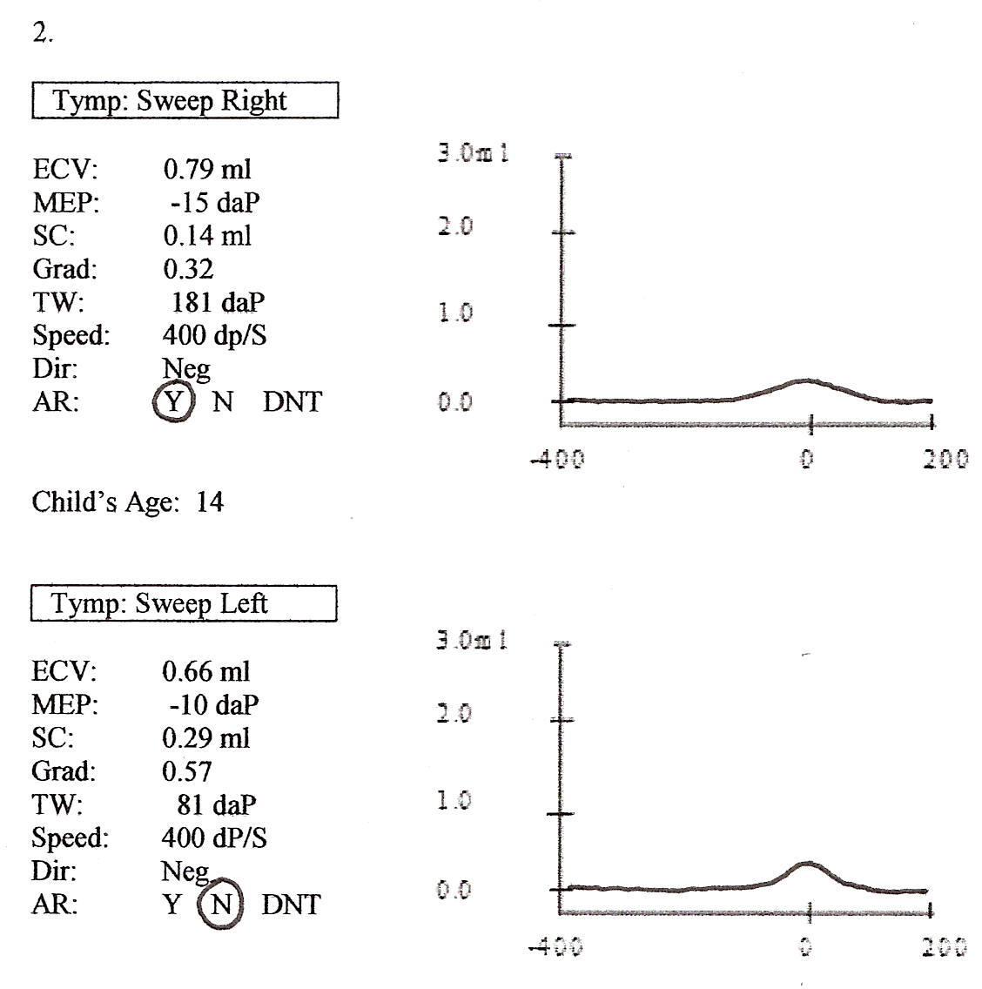
Scenario 8
Results
  ECV normal
  Compliance seems low
  MEP is normal
  AR is present

Slide 178
Scenario 8 (continued)
Suggest
  Normal middle ear function.
Why
  Although compliance is somewhat low, a peak is noted AND an acoustic reflex is present.

Slide 179

Immittance Failure Criteria
Adapted from ASHA Guidelines
  Both ASHA and AAA are reviewing guidelines for hearing screening.
  Negative MEP will be critically reexamined because it is seldom treated unless other concerns are noted.
  Screening failure criteria likely to be influenced by American Academy of Pediatrics guidelines which, to a significant degree, take a “wait and see” approach to ME problems.

Slide 180

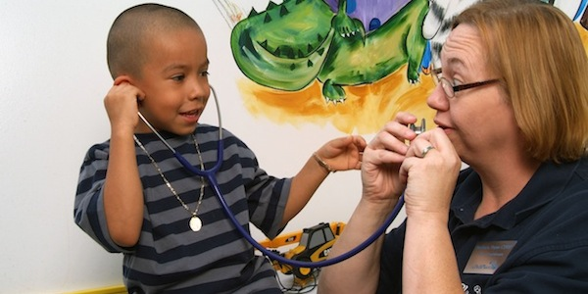
    Educational vs. medical concerns

Slide 181
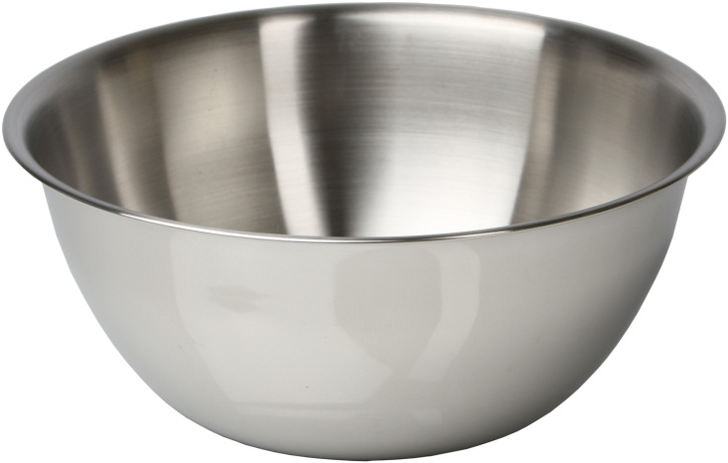

    Practice Interpreting Results

Slide 182
Immittance Failure Criteria
ECV Failure Criteria (Ranges only; ECV must be viewed in relationship to compliance and MEP)
Preschoolers
  .3-.9 (without tubes)
  1.2-5.5 (with tubes)
Elementary students (1st-5th )
  1.1-2.1
Add one EVC

Slide 183

Immittance Failure Criteria
Compliance Failure Criteria
  <.2 ml; however, if the compliance is .1 AND a peak is observed AND an AR is present, it is a pass
MEP Failure Criteria
  +100 to -250 daPa
Add one TM compliance
Add one MEP

Slide 184

The Wyoming Hearing Health History
(HHH) System…
…has a verification tool for immittance.
More on this tomorrow…

Slide 185

QUESTIONS, COMMENTS, CONCERNS?

Slide 186
Otoscopic Inspection
A cursory view of the external ear
The otoscope is not a hammer
As a safety measure, have your hand touch the child’s head before the otoscope
Only fail when foreign object or drainage is present
Don’t ask permission

Slide 187
Otoacoustic Emissions (OAEs)
It is not a hearing screen
It is a screen of cochlear function
Screens through the cochlea, but not beyond the cochlea
Objective; requires no response from the child
Equipment is expensive and fragile

Slide 188
What are Otoacoustic Emissions
Otoacoustic Emissions (OAEs) are acoustic responses associated with the normal hearing process. If the emissions are present, then the cochlea is functioning normally, which means that the hearing is most likely normal. It the emissions are absent, and there are no other medical contraindications (i.e. tubes or otitis media) then the cochlea is not responding typically and there may be a hearing loss present.

Slide 189
Pure Tones
Pure tone screening screens at lower decibel levels than OAEs
Appropriate when a child reaches a developmental age of approximately 3 years

Slide 190
Pure Tones to Screen:
1,000 Hz
2,000 Hz
4,000 Hz
@ 20 dBHL
☺ In each ear!! ☺

Slide 191
Why these frequencies and this level?
Help us identify hearing loss in the frequencies critical for understanding speech
Lower frequencies such as 250 and 500 Hz are problematic due to room noise
20 dB can identify mild/moderate hearing loss and is appropriate for screening outside a sound booth
Recommended by ASHA

Slide 192
Pure Tone Screening
Don’t present tones in a rhythmic pattern
Cuing; looking up when you present a tone
Avoid long directions; ‘less is more’
  Not necessary; can pantomime; i.e. ESL child
Proper earphone placement
  The “earring thing”
  Collapsing ear canals
  Red phone, right ear; blue phone, left ear

Slide 193
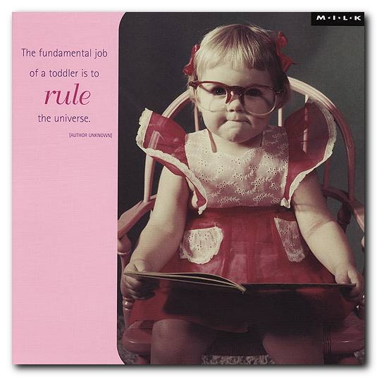

Slide 194
Conditioned Play Audiometry (CPA)
Using Pure Tones
Appropriate for children at a developmental age of approximately 3 years
Seldom necessary in the k-12 population though appropriate for children with developmental disabilities
Try traditional technique (hand-raising) first

Slide 195
Pure Tones
Test your own hearing in the room before beginning screening
  If you can’t hear the tones, you need to find another location
  NEVER increase the presentation level to ‘accommodate’ a noisy environment
Calibration – needed annually!

Slide 196
Rescreening and Referrals

Slide 197
Rescreening
All children failing any portion of PT/OAE, immittance, or otoscopic screening are rescreened in 4-6 weeks
  Pure tones (one frequency in one ear)
  OAE screening equipment identifies “pass vs. refer”
  Immittance (compliance, MEP, volume)
  Otoscopic (foreign object, draining ear)

Slide 198
Rescreening
4-6 weeks allows for problems (middle ear) to resolve on their own if they are going to
60-70% of students who fail the first screening will pass the rescreen (for whatever reason)
Not rescreening will result in over-referrals which is ultimately detrimental to the screening program!
  Lacks specificity

Slide 199
Rescreening
Rescreening consists of performing otoscopic inspections, PT/OAE screening, and immittance measures on both ears
  Everybody gets everything
  May help provide a ‘history’ which is useful to the person getting the referral

Slide 200
Referrals: Getting Bang for the Buck
Immittance failures Primary Care Physician
PT/OAE failures Audiologist

Slide 201
Referrals
Whether you are referring to a physician or to an audiologist it will be helpful if they have the screening results (DATA system will generate)
  Tells them the “what, when, and how long”
  Faxing/Mailing often better than sending with parents
    This requires parent permission

Slide 202
HIPAA and FERPA
Ensuring that children who do not pass the screening test receive appropriate follow-up almost always requires coordination with other state and private agencies, which often requires sharing of data
HIPAA (Health Insurance Portability and Accountability Act)
FERPA (Family Educational Rights and Privacy Act)

Slide 203
Hearing Evaluations
Child Development Centers are responsible for audiological evaluations when indicated from hearing screening.
  Private insurance and Medicaid can be used

Slide 204
Referrals
An audiologist will need a referral from the child’s Primary Care Physician to be able to bill insurance and Medicaid.
Parents should have primary care physician make the prescription out for hearing evaluation and treatment. If the child has a hearing loss, the parent won’t have to get a second referral for hearing aids.

Slide 205
Referral to an Audiologist
You should receive a written report from the audiologist
  Description of type and degree of hearing loss
  How the hearing loss might impact performance
  Recommendations (including when/if to return for next audiological evaluation)
http://www.wyomingehdi.org

Slide 206
Referrals: Examples
Fail PT and immittance
  PCP > Rescreen > Audiologist if PTs still failed
Tubes are noted; PTs are passed; immittance suggests tubes are patent
  Results to physician > Rescreen in 3 months
Tubes are noted; PTs not passed; immittance suggests tubes are patent
  Audiologist

Slide 207
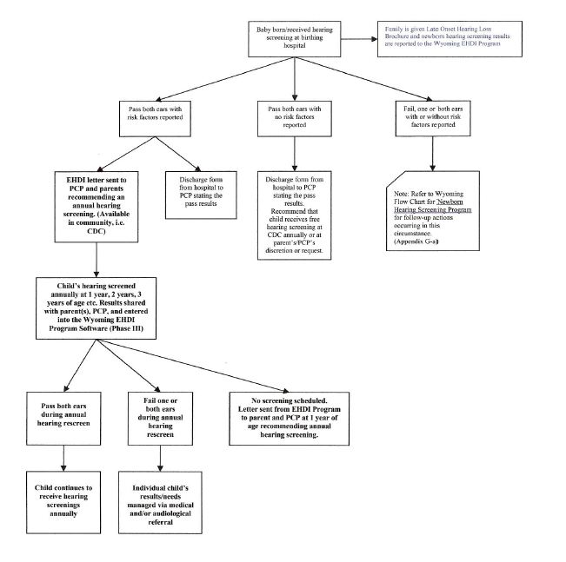

Flow as the river!

Slide 208
Communicating Results to Parents/Physicians
Diagnosis is in the physician’s realm
“Screening results were consistent with; support the presence of…”

Slide 209
Contacting Parents
Phone call typically helps to support the form letter
Keep it simple
  Terms such as immittance and pure tones probably won’t be understood
Ask questions about recent colds, allergies, history of ear problems, etc.

Slide 210
CLICKER TIME!
When a child fails both immittance screenings and pure tone/OAE screenings two times, to whom do you refer the child?
Audiologist
Medical Doctor (Primary Care Physician/ENT)
No Referral is needed after two screens

Slide 211
Wyoming Pediatric Audiology Specialty Clinic
Comprehensive audiologic evaluation of young infants is a very specialized task and a difficult task, requiring special equipment, multiple visits, commitment of considerable time, and clinician expertise with this age group. As a result of the low volume of infant audiologic assessments, care of infants may occur in facilities designed primarily for evaluation of adults and older children or take place outside of the state of Wyoming.
Notes:
I didn’t make any changes to these next few slides so please update/change as needed.

Slide 212
Wyoming Pediatric Audiology Specialty Clinic
The Wyoming Pediatric Audiology Specialty Clinic is designed to provide age appropriate and timely evaluation for infants and young children who fail their newborn and/or late onset hearing screenings. A speech/language assessment may also be completed to assess any speech/language delays that may exist.

Slide 213
Wyoming Pediatric Audiology Specialty Clinic
The Clinic is held at two locations
University of Wyoming
Speech & Hearing Clinic
9th and Clark Street
Laramie, Wyoming 82071
Child Development Services of Natrona County
2020 East 12th Street
Casper, Wyoming 82601

Slide 214
Wyoming Pediatric Audiology Specialty Clinic Staff
Susan Fischer, M.S., CCC-SLP
Speech Language Therapist
Clinic Coordinator
Teresa Garcia, M.S., CCC-A
Clinical Audiologist
Nancy Pajak, M.S., CCC-A
Educational Audiologist
Kim Reimann
Parent Advocate
Bradley H. Bakken
Administrative Assistant

Slide 215
Affiliate Clinics
BRC Family Hearing Solutions
Rebecca Price
(307) 875-1460
Green River
Fremont Ear, Nose, & Throat
Rebecca Price
(307) 875-1460
Lander
Audiology and Tinnitus Center of Cheyenne
Ruby Zubrod
(307) 514-0292
Cheyenne

Slide 216

Putting It All Together
Notes:
animated

Slide 217
Components of Hearing Screening and the Criteria for Failure
Otoscopic Inspection
Pure Tone Screening (20 dB at 1,000, 2,000, and 4,000 Hz)
  Failure to respond to at least one tone in at least one ear
    -OR-
OAE Screening
  Refer or Test Invalid

Slide 218
Components of Hearing Screening and the Criteria for Failure
Immittance Screening
  +100 to -250 MEP
  Compliance < .2 (note: if the compliance is .1 AND a peak is observed AND an AR is present, it is a pass)

Slide 219
CLICKER TIME!
It is okay to screen at 25 dBHL if the room is noisy and the child can’t hear the tone at 20 dBHL.
True
False
Only if the physical education teacher is in the building

Slide 220




It Takes A Village?
And then some!!!

Slide 221

Coordinating care takes a CEO…
and an air traffic controller!

Slide 222
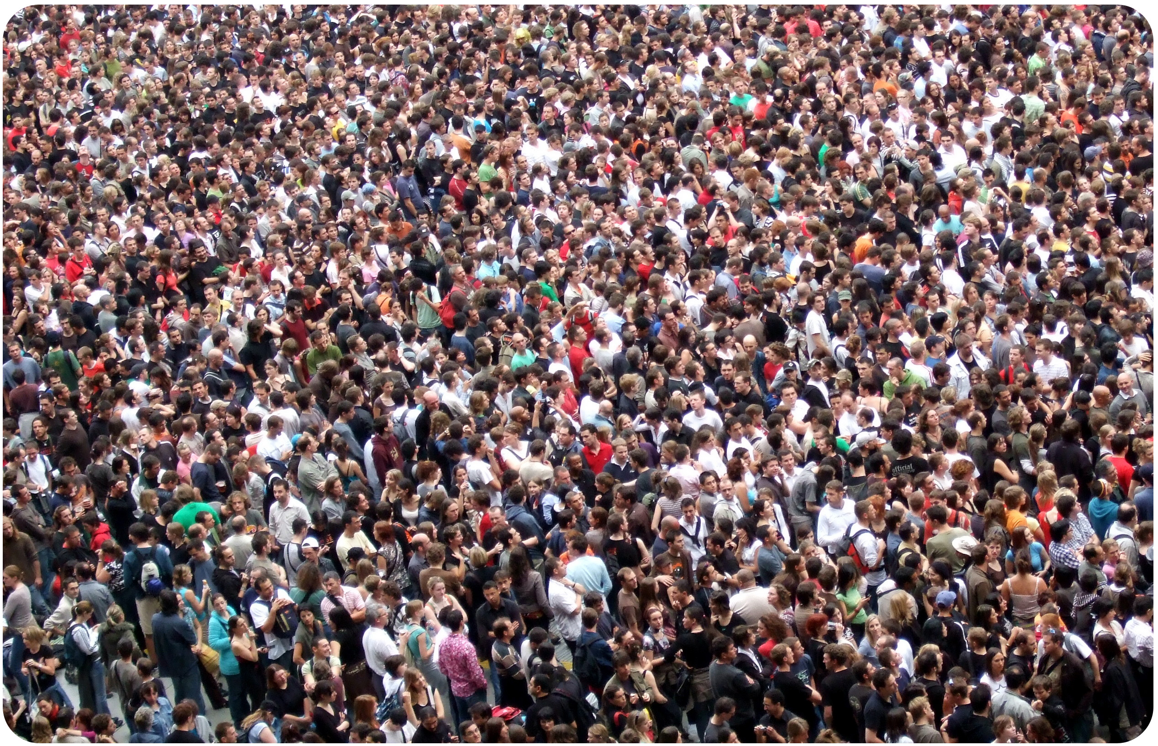
Our Village is Called a “Medical Home”
Parent(s), child, siblings, grandparents, aunts, uncles, child care provider, primary care physician, audiologist, ENT, family service coordinator, early interventionist, speech language pathologist, occupational therapist, physical therapist, teacher of the deaf/hard of hearing, second audiologist (fitting hearing aids, making earmolds), CI center audiologist, case manager, waiver manager, children with special healthcare staff, public health nurse, Medicaid/Kid Care staff, medical insurance company staff, home owners insurance staff, et cetera…

Slide 223
Equipment
MSR West; 1-800-777-4130
  Calibration must be done annually.
    Contact MSR West in the late spring, if someone is in the ‘hood, they may be able to pick it up and save you shipping.

Slide 224
Supplies
Disposable specula is great
  Adult specula; 4.25mm
  MMS Medical Supply Co.
  Approximately $33.00 for a bag of 850
  1-800-777-2634
  www.mmsmedical.com
Germicidal wipes
Surge protector
Electrical adaptor

Slide 225
CLICKER TIME!
How often should your hearing screening equipment be calibrated?
Every Week
Annually
When the moon is in Aquarius

Slide 226
Wyoming Hearing Health History (HHH) System
Great record-keeper!
Will generate referral letters
Keeps track of pending screenings
Will tabulate reports
More tomorrow…

Slide 227
Remember…
Prior and Proper Planning
Prevents
Poor Performance

Slide 228
Please complete the post-test. When finished, pass it to Bradley.
☺ GREEN ☺

Slide 229
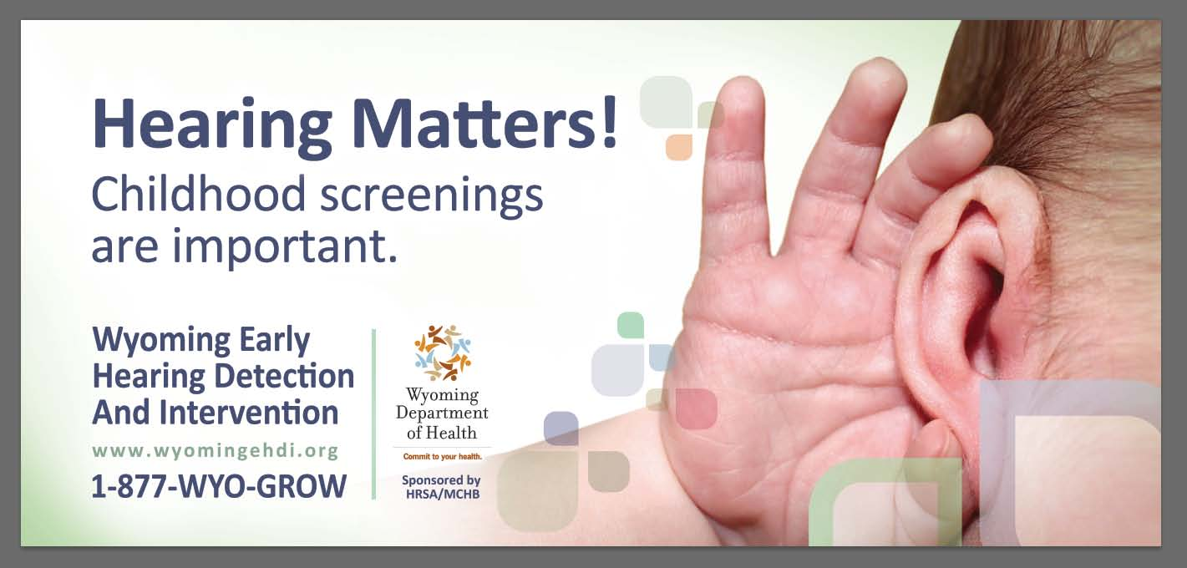

Slide 230

Thank You for Coming!!!
Its All About the Ears….

